Slide 1
How to Maintain Compliance as a PWS
Latricia Lord, Senior Environmental Health Specialist
Northern Nevada Public Health
llord@nnph.org
775-328-2689

Slide 2
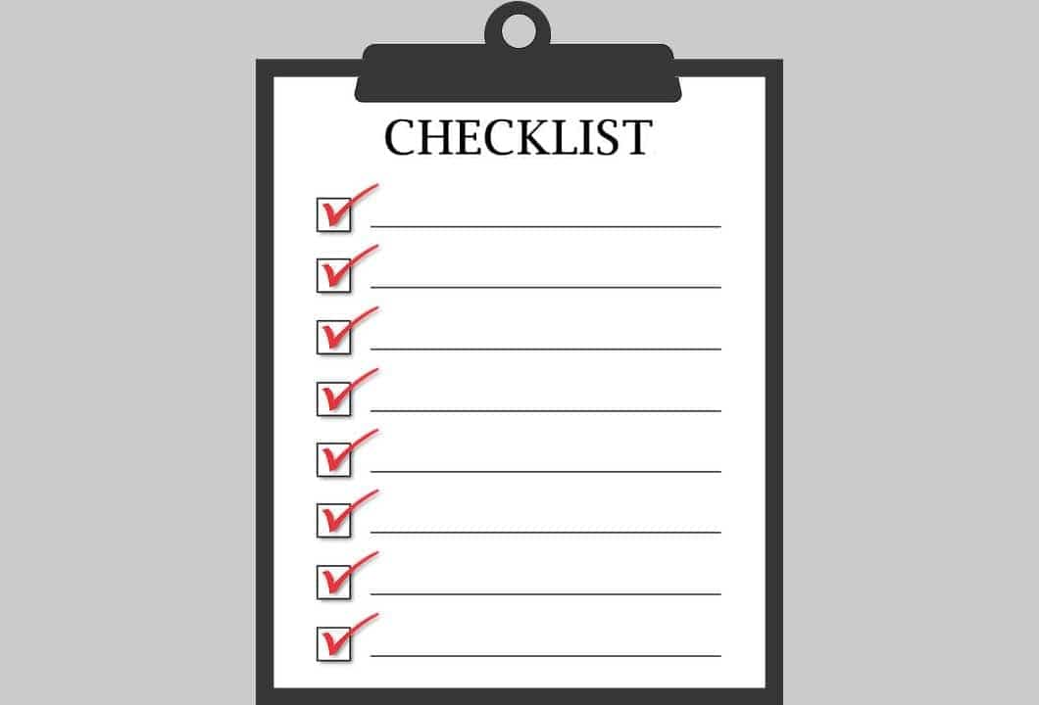
Presentation Overview
Agency Responsibilities (BSDW/NNPH/SNHD)
We are all Rule followers…
Monitoring compliance
Collecting samples
Sample plans
Planning ahead
Responding to exceedances
Level 1 and Level 2 Assessment Compliance
Lead and Copper Rule Compliance
Sanitary Survey Compliance
Public Notification Compliance
Water Projects Compliance

Slide 3
Agency Responsibilities
The Nevada Division of Environmental Protection Bureau of Safe Drinking Water (NDEP-BSDW) has primacy over Public Water Systems (PWS’s) in Nevada and is responsible for implementation of the Safe Drinking Water Act in Nevada.
Northern Nevada Public Health (NNPH) and Southern Nevada Health District (SNHD) are contracted with NDEP- BSDW to oversee compliance activities associated with all PWS’s serving Groundwater in Washoe and Clark Counties, respectively.

Slide 4
Rules, Rules, Rules!
Revised Total Coliform Rule: Applies to every public water system
Ground Water Rule:
Applies to every system serving groundwater. Triggered with TC+ samples.
Disinfection Byproduct Rule:
Applies to Community & NTNC systems that disinfect
Lead and Copper Rule: Applies to Community & NTNC systems
Chemical Monitoring Rule:
Applies to every system for Nitrate, Nitrite & Secondary IOC’s
Consumer Confidence Rule: Applies to Community systems
Surface Water Treatment Rule:
Applies to every system serving Surface Water
Public Notification Rule: Applies to every system. Three tiers of public notification and certification
Applies to Community & NTNC for Arsenic, IOC’s, VOC’s, SOC’s, Rad’s
PFAS Rule:
Applies to Community & NTNC systems
Pro-Tip: Every Federal Rule has a Quick Reference Guide available on the EPA website that lists the most important items of the Rule and can help you stay in compliance with that rule.
https://www.epa.gov/dwreginfo/drinking-water-rule-quick-reference-guides

Slide 5
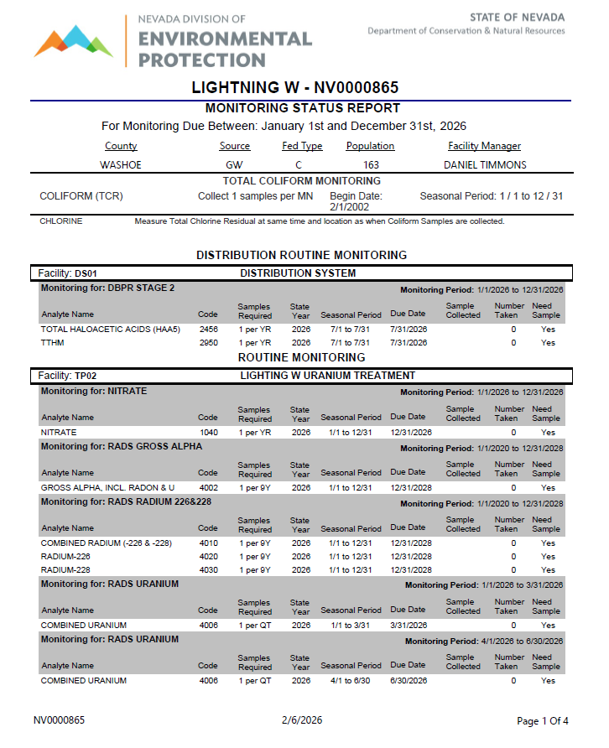
Monitoring Compliance- Collecting Samples
Collecting samples:
Every PWS must collect samples according to established schedules and system type.
Non-Community (NC) (aka Transient)
Non-Transient Non-Community (NTNC)
Community (C)
PWS’s operators are responsible for knowing what samples are required.
Monitoring Status Reports are sent out twice a year by regulating agency.
Shows federal type, current population, and Facility Manager.
Lists Coliform requirements, then Distribution System, then individual facilities where samples are to be collected
Watch State Year & Seasonal Period closely on this report.
Contact your Facility Manager if you have questions about requirements.
Date at bottom of page indicates date report was generated.
PWS’s are responsible for utilizing a Nevada Certified Drinking Water Lab.
Certified lab list is available on BSDW website:
https://ndep.nv.gov/water/lab-certification

Slide 6
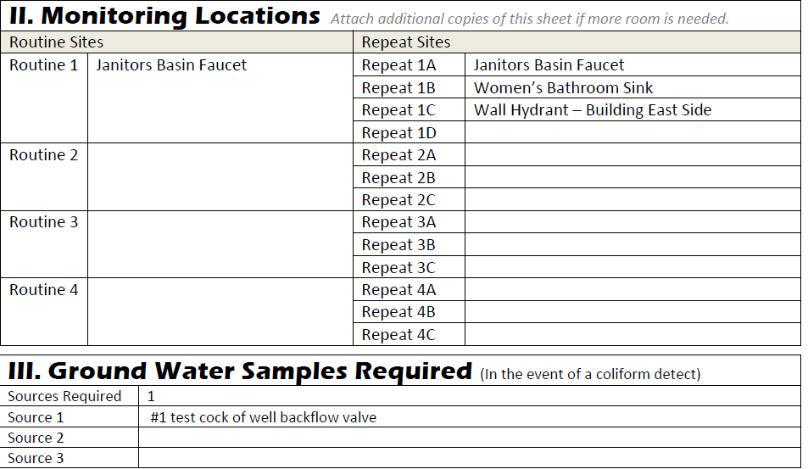
Monitoring Compliance- Follow your sample plans
Sample Plans: All locations on plans have been reviewed & approved by a regulatory agency for a specific reason:
Total Coliform Rule-
Routine site(s) should be a good representation of distribution system.
Repeat samples also are a representation of the distribution system. Must be collected within 24 hours of notification of TC+.
Use same site location terminology on your COC.
Groundwater Rule- GW source samples in use at time TC+ collected must be collected within 24 hours of notification of TC+.
Disinfection Byproducts Rule- sample sites usually at maximum disinfection residence time.
Lead and Copper Rule- sites have been selected to meet appropriate tier location.

Slide 7
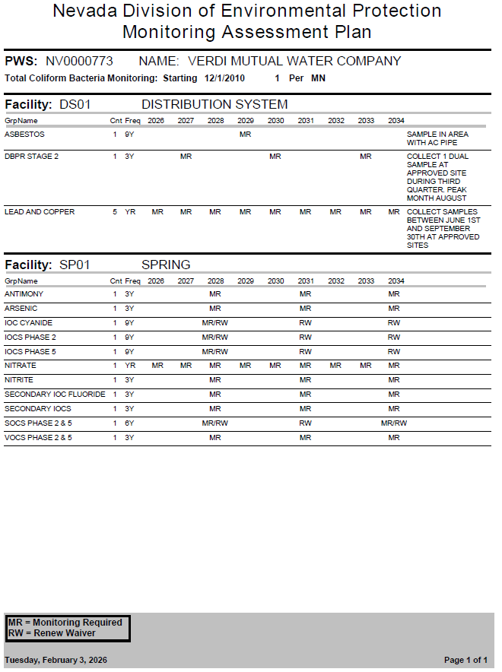
Monitoring Compliance- Planning Ahead
PWS’s can request 9-year Monitoring Assessment Plan (MAP) for future planning.
May list specific guidance in Notes section (e.g., seasonal collection periods).
MR means monitoring is required during that timeframe.
RW means renew monitoring waivers that year. Failure to renew waivers can result in waiver revocation.
If there are chemical detections, exceedances or missed samples, sampling frequencies can change.
These reports are not automatically sent to PWS’s but can be requested at any time.
Date at bottom of page indicates date report was generated.
Sample schedules are also available on Drinking Water Watch. https://ndwis.ndep.nv.gov/DWW/

Slide 8
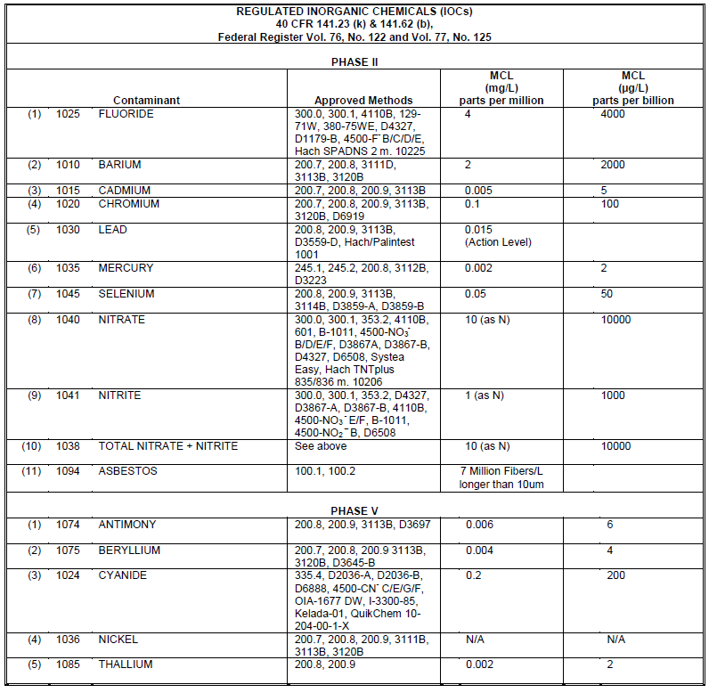
Monitoring Compliance- Responding to exceedances
Responding to exceedances:
PWS operators are responsible for knowing if a constitute has exceeded a Maximum Contaminate Limit (MCL).
Required analytes and their MCL’s are posted on the BSDW website.
https://ndep.nv.gov/water/drinking-water/information-for-public-water-systems/chemical-monitoring
Additional monitoring almost always required after an exceedance.
Report exceedance to your Facility Manager and ask for next steps.
MCL violations typically result in an increased monitoring frequency. Violations letters will include an updated Monitoring Status Report.
MCL violations also require Public Notice according to a Tier system.

Slide 9
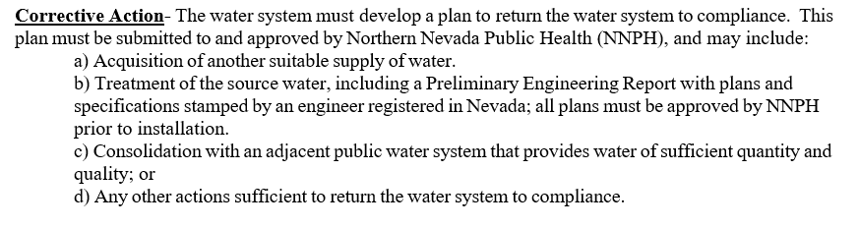
Monitoring Compliance- Responding to exceedances
Corrective Action Plans:
Exceedances require a Corrective Action Plan be submitted to your regulating agency for review and approval.
Must include specific actions and dates of compliance (milestones).
Proposed dates should be reasonable and extensions are allowed.
Extensions should be requested before the compliance date and not after the fact.

Slide 10
Level 1 and Level 2 Assessment Compliance
PWS operators are responsible for knowing if a there has been an Assessment Trigger.
Level 1 Assessment Triggers:
PWS collecting <40 TC samples/month has 2 or more TC+ routine/repeats
PWS collected ≥40 TC samples/month has >5% of routine/repeats TC+
PWS fails to collect every required repeat sample after a TC+.
Level 2 Assessment Triggers:
PWS incurs an E. coli MCL violation
PWS has a second Level 1 Assessment with rolling 12-month period
Conducting Assessments:
Level 1 Assessments can be performed by the PWS owner or operator and must be submitted to regulatory agency within 30 days of the trigger.
Level 2 Assessments must be performed by state or state approved entity. PWS is responsible for ensuring Level 2 Assessment is conducted regardless of entity conducting it.
Correcting Deficiencies:
Must be corrected within 30 days or within state-approved timeframe as proposed on Assessment form.

Slide 11
Lead and Copper Rule Compliance- what can lead to a violation?
Lead Service Line Inventory:
Failure to submit a service line inventory
Failure to submit a completed inventory
Failure to make the inventory publicly accessible
Failing to certify that the annual notice of known or potential service lines containing lead has been completed
Action Level Exceedance Response:
Failing to follow corrosion control treatment steps after an action level exceedance (ALE)
Failing to issue public notice and public education after an ALE within the required timeframe
Failing to certify that the consumer tap notice has been completed.
If you are not sure of the requirements reach out to your regulating agency.

Slide 12
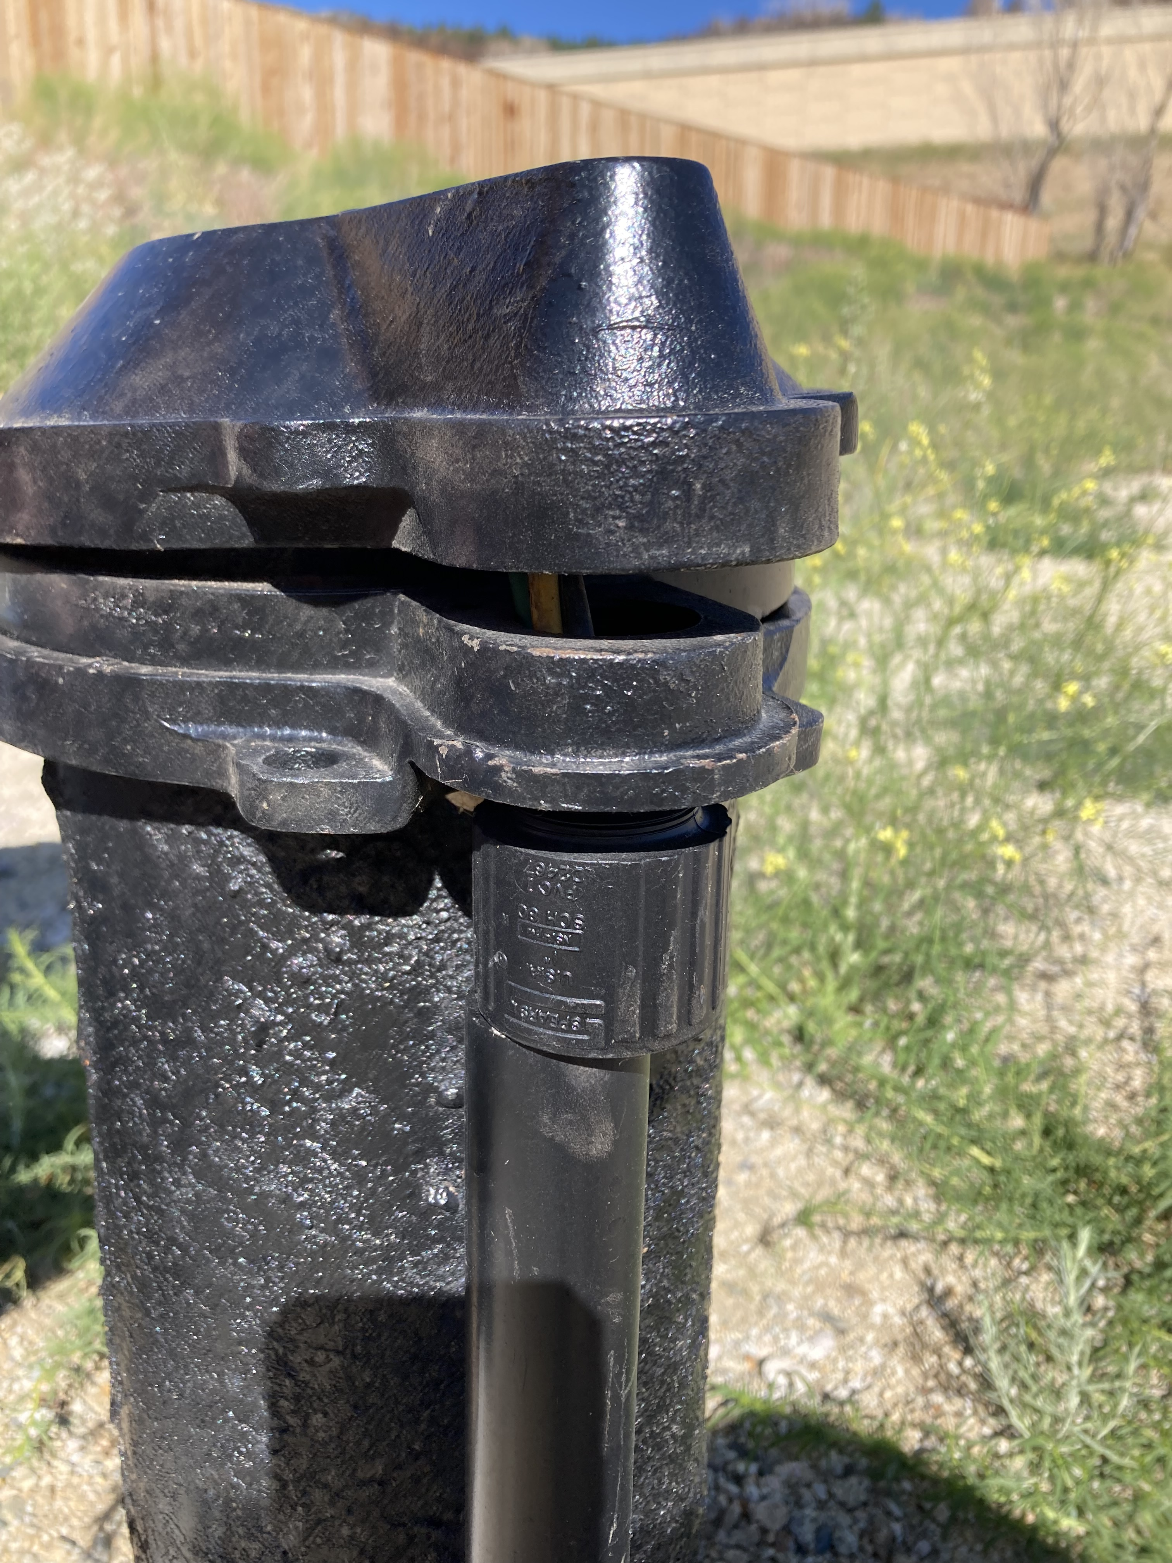
Sanitary Survey Compliance- What will be inspected?
Purpose of a sanitary survey: To assess a water systems capacity to deliver safe water, identify potential risks and provide technical assistance.
Frequency: Yearly for surface water systems, every 3 years for groundwater systems
Items evaluated during a sanitary survey:
Source: Physical condition and protection of raw water.
Treatment: Evaluation of plant design, operation, and efficiency.
Distribution System: Condition and pressure management.
Finished Water Storage: Security, maintenance, and cleanliness.
Pumps/Facilities/Controls: Operational status.
Monitoring/Reporting/Data Verification: Review of sampling, records, and compliance.
System Management/Operation: Organizational competence.
Operator Compliance: Certification status.

Slide 13
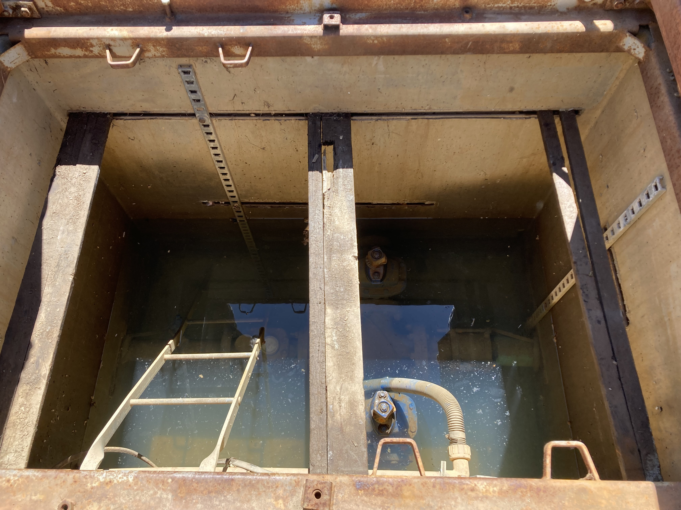
Sanitary Survey Compliance- Preparing for a Sanitary Survey
Visit every site regularly & evaluate for sanitary defects
Ensure well caps are secured and watertight, and vents are screened.
Ensure water is pumped out of vaults regularly.
Ensure tank lids are secured and watertight, and vents are screened.
Emergency Response Plan (ERP), Operation and Maintenance (O&M) Manual and Cross Connection Control Plan (CCCP) are living documents. Update them regularly.
Ensure a knowledgeable person will be available to accompany the inspector.
Ensure you can access all water system facilities with the inspector.
Bring keys, access tools, ladders, etc.
Have applicable paperwork ready
Most current sampling plans, ERP, O&M Manual and CCCP
Recent backflow test results
Test kit calibration verification records, operator demonstration of capability, etc.
Most current Lead Service Line Inventory

Slide 14
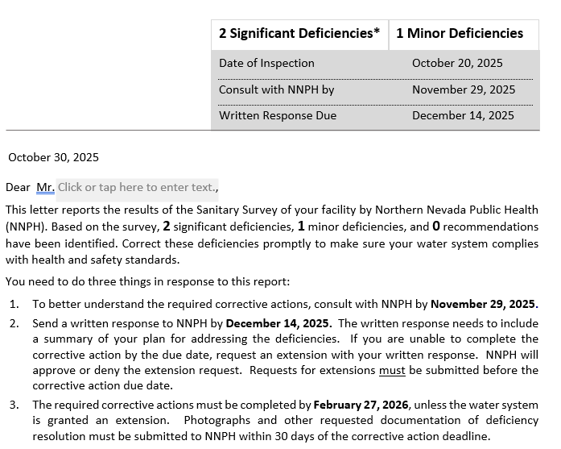
Sanitary Survey Compliance- Responding to the Report
If your facility has a significant deficiency:
Within 30 days: Consult with your regulating agency to discuss how you plan to proceed.
Within 45 days- provide a written response to your regulating agency that includes a summary of your plan for addressing the deficiency.
Within 120 days- correct any deficiency or have an approved corrective action plan on file with your regulating agency.
Within 30 days of fixing a deficiency- inform your regulating agency and include photographs or other documentation that supports your resolution of the deficiency.

Slide 15
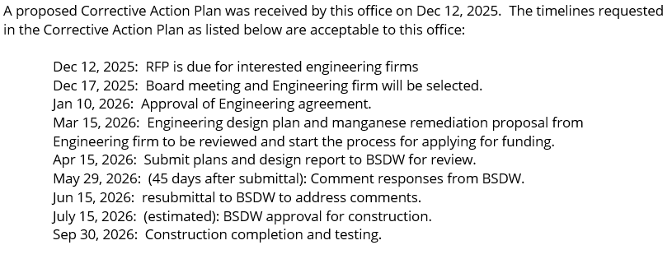
Sanitary Survey Compliance- Corrective Action Plans
Corrective Action Plans:
If your facility has a significant deficiency that can’t be corrected within 120 days a Corrective Action Plan will be required:
Must include specific actions and dates of compliance (milestones).
Subject to review and revision by your regulating agency.
Proposed dates should be reasonable and extensions are allowed.
Extensions should be requested before the compliance date and not after the fact.

Slide 16

Public Notice Compliance- Tiers
Tier 1- Required within 24 hours when there is an immediate, significant risk to human health
E. coli contamination, Nitrate MCL violation, Lead Action Level Exceedance
Must use media outlets such as television, radio, and newspapers, post their notice in public places, personally deliver a notice to their customers, or an alternative method approved by the regulating agency
Tier 2- As soon as possible but required within 30 days of the violation.
Required when water systems exceed EPA or state standards or if water hasn’t been treated properly but doesn’t pose an immediate health risk.
Notice may be provided via the media, posting, or through the mail.
Tier 3- Required annually when violating a drinking water standard that does not have a direct impact on human health (example: monitoring violations)
Notice may be provided via the media, posting, or through the mail.
Consumer Confidence Reports (CCR) can be utilized by Community Water Systems for Tier 3 notifications.
Due to water system customers by July 1st of each year.
Certificate of Delivery due to regulatory agency by Sept 1st of each year showing CCR was delivered to customers.
Templates: Templates provided by your regulatory agency will contain all required items with some items that must be completed by the water system as every situation is unique.

Slide 17
Water Projects Compliance
When is a water project required? During initial construction, renovation, modification or expansion, of:
1. Each portion of a public water system that begins operation after February 20, 1997; or
2. Each portion of a public water system that began operation on or before February 20, 1997, if the portion of the public water system is involved in:
(a) The collection, pumping, treatment, storage or distribution of water; or
(b) The boosting, sustaining or reducing of water pressure, except any construction, renovation, modification or expansion approved by the Division of Public and Behavioral Health, the appropriate district board of health or other appropriate governmental entity before February 20, 1997.
During Construction:
Work on a water project must be performed per the approved plans. Approval is required for any proposed changes in materials, equipment, quantities, configurations or processes, and before any additions or deletions of infrastructure, which would affect the quality or quantity of water.
The water project must be inspected by qualified representatives of the water system.
After Construction:
Within 30 days of completion the water system must certify the project was completed in substantial compliance with the approved plans.
Treatment plant projects come with an additional permit and requisite fee. An invoice will be sent by BSDW and once paid, they will issue the new permit.

