Slide 1
Nevada Water Operator Exam Summaries 1st Quarter 2023 (PBT Only)
NDEP Bureau of Safe Drinking Water
Operator Certification Program

Slide 2
2023 1st Quarter - Distribution
First Quarter 2023 Summary of Distribution OpCert Exams
Distribution | Date | Test | Total | Pass | Fail | % Pass | Low Grade | High Grade | Median | Most Missed
1 | Q1 | PBT | 22 | 17 | 5 | 77% | 56 | 93 | 73.5 | System Components/Equipment IOM
2 | Q1 | PBT | 7 | 3 | 4 | 42% | 57 | 92 | 65 | SSA & Public Interactions
3 | Q1 | PBT | 1 | 1 | 0 | 100% | 80 | 80 | 80
4 | Q1 | PBT | 2 | 0 | 2 | 0% | 60 | 64 | 62 | System Components/Disinfection MEA & Lab
 |  |  | 32 | 21 | 11 | 66%
DISTRIBUTION CATEGORIES:
System Information & Components
Equipment; Install, Operate and Maintain
Monitor, Evaluate & Adjust Disinfection & Lab
Security, Safety, Public Interaction & Administrative Procedures

Slide 3
2023 1st Quarter - Distribution
First Quarter 2023 Summary of Distribution OpCert Exams
Distribution | Date | Test | Total | Pass | Fail | % Pass | Low Grade | High Grade | Median | Most Missed
1 | Q1 | CBT | 46 | 29 | 17 | 63% | 43 | 93 | 72 | System Components/Equipment IOM
2 | Q1 | CBT | 22 | 13 | 9 | 59% | 57 | 90 | 72 | Disinfection MEA & Lab
3 | Q1 | CBT | 13 | 9 | 4 | 69% | 55 | 89 | 71 | Disinfection MEA & Lab
4 | Q1 | CBT | 5 | 4 | 1 | 80% | 61 | 78 | 73 | System Components/Disinfection MEA & Lab
 |  |  | 86 | 55 | 31 | 64%
DISTRIBUTION CATEGORIES:
System Information & Components
Equipment; Install, Operate and Maintain
Monitor, Evaluate & Adjust Disinfection & Lab
Security, Safety, Public Interaction & Administrative Procedures

Slide 4
2023 1st Quarter - Treatment
First Quarter 2023 Summary of Treatment OpCert Exams
Treatment | Date | Test | Total | Pass | Fail | % Pass | Low Grade | High Grade | Median | Most Missed
1 | Q1 | PBT | 11 | 6 | 5 | 54% | 58 | 92 | 72 | Equipment O&M/Lab/Treatment
2 | Q1 | PBT | 2 | 1 | 1 | 50% | 51 | 81 | 66 | Equipment O&M/Lab/Treatment
3 | Q1 | PBT | 0 |  |  | 0%
4 | Q1 | PBT | 0 |  |  | 0%
 |  |  | 13 | 7 | 6 | 54%
TREATMENT CATEGORIES:
Treatment: Monitor, Evaluate and Adjust
Laboratory Analysis
Operate and Maintain Equipment
Evaluate Characteristics of Source Water
Perform Security, Safety & Administrative Procedures

Slide 5
2023 1st Quarter - Treatment
First Quarter 2023 Summary of Treatment OpCert Exams
Treatment | Date | Test | Total | Pass | Fail | % Pass | Low Grade | High Grade | Median | Most Missed
1 | Q1 | CBT | 7 | 6 | 1 | 86% | 64 | 85 | 80 | Laboratory Analysis
2 | Q1 | CBT | 6 | 5 | 1 | 83% | 64 | 94 | 74 | Treatment
3 | Q1 | CBT | 1 | 1 | 0 | 100% | 74 | 74 | 74
4 | Q1 | CBT | 2 | 0 | 2 | 0% | 55 | 62 | 59 | Source Water
 |  |  | 16 | 12 | 4 | 75%
TREATMENT CATEGORIES:
Treatment: Monitor, Evaluate and Adjust
Laboratory Analysis
Operate and Maintain Equipment
Evaluate Characteristics of Source Water
Perform Security, Safety & Administrative Procedures

Slide 6
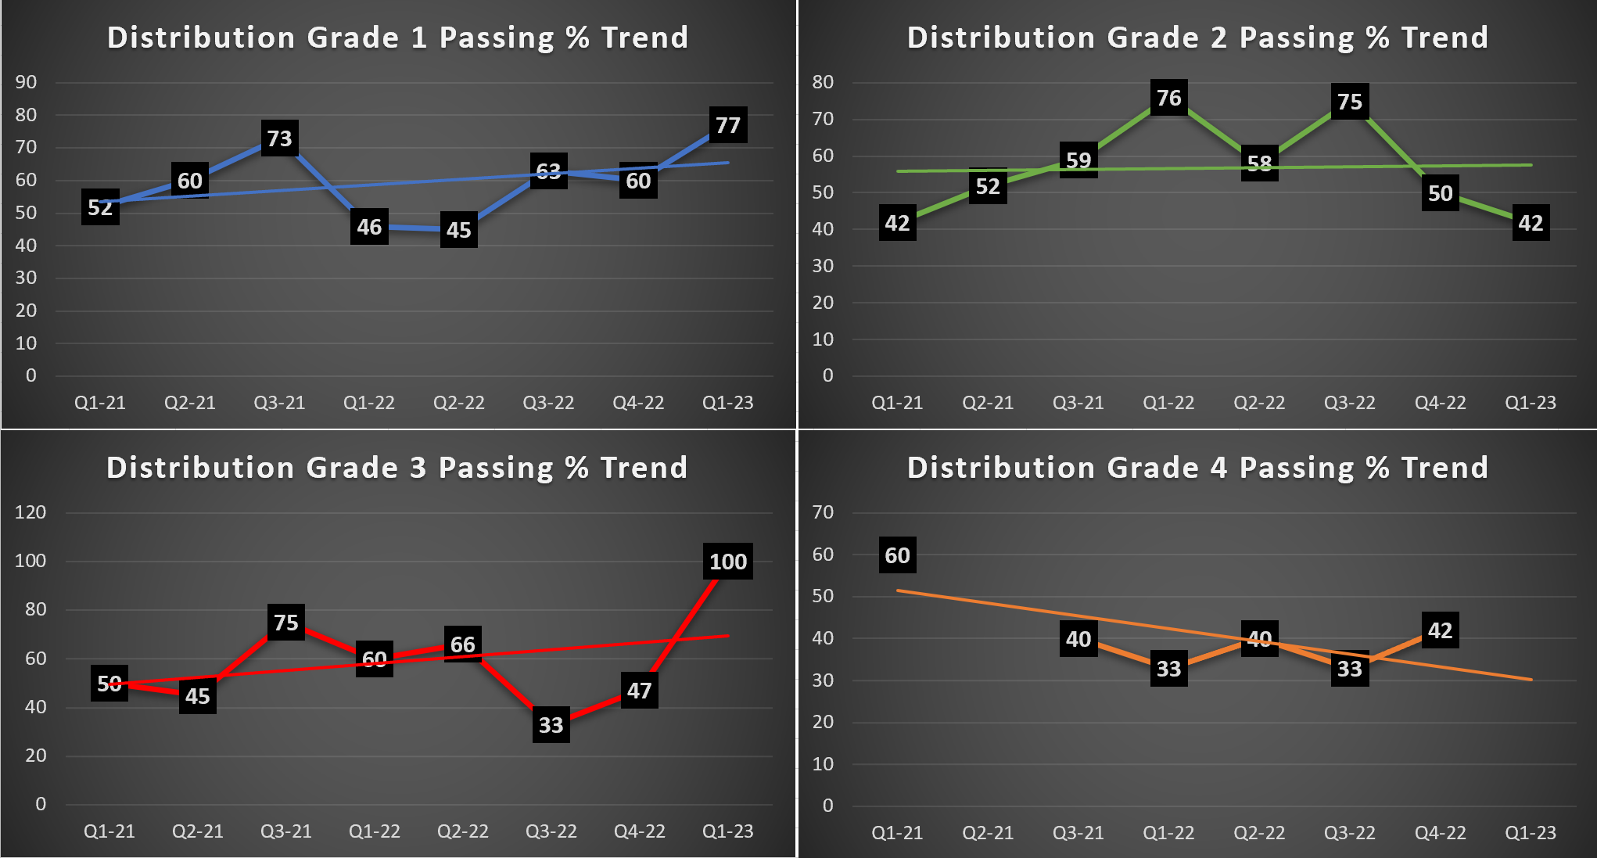
Passing Percentage Trend 2021-2023 (PBT For Q1-23)

Slide 7
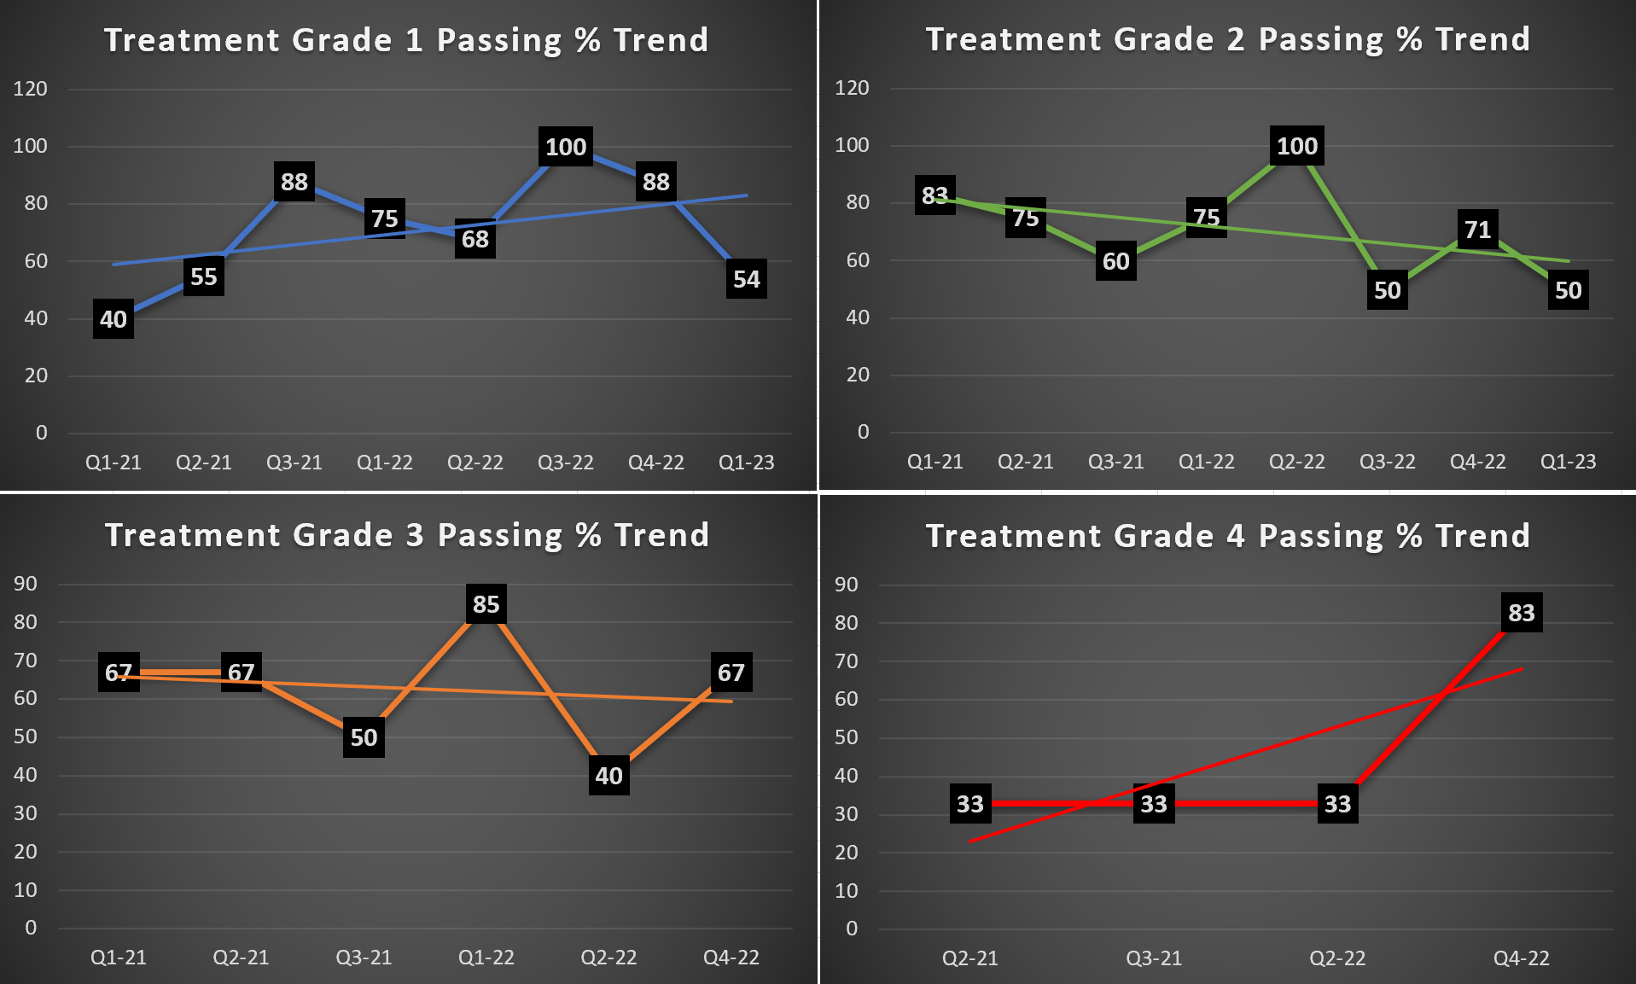
Passing Percentage Trend 2021-2023 (PBT For Q1-23)

Slide 8
NDEP Bureau of Safe Drinking Water
Operator Certification Program
Bureau Chief Andrea Seifert, P.E.
Data Mngmnt / OpCert Supervisor Linh Kieu
Program Manager Carlos Quiroz
Administrative Specialist Rachel Weingart

