Slide 1


NDEP BSDW Discussion
NDEP Bureau of Safe Drinking Water
Operator Certification Program

Slide 2
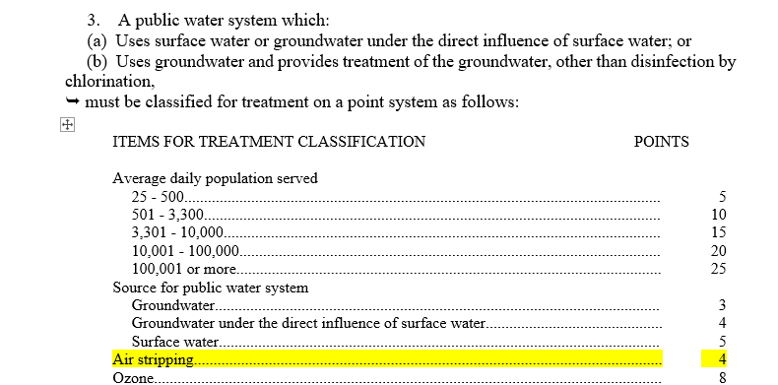
Storage Tank Aerators – TTHM Removal
NAC 445A.629.3

Slide 3
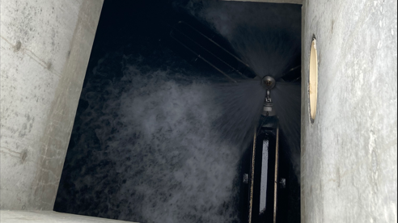

Slide 4
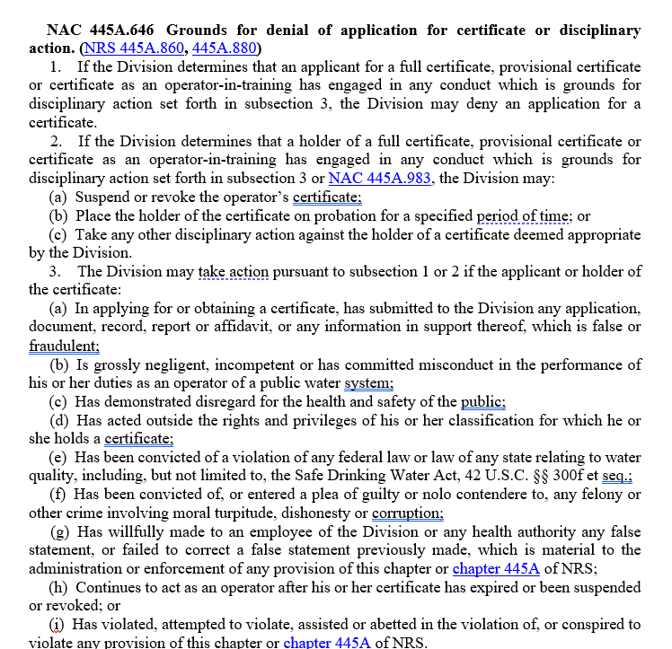
Disciplinary Action NAC 445A.646

Slide 5
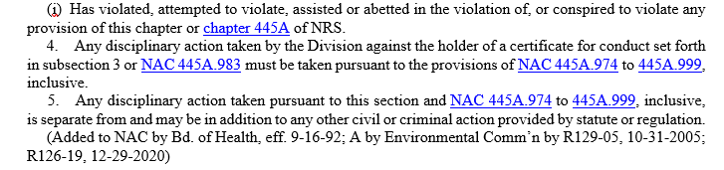
NAC 445A.646.4

Slide 6
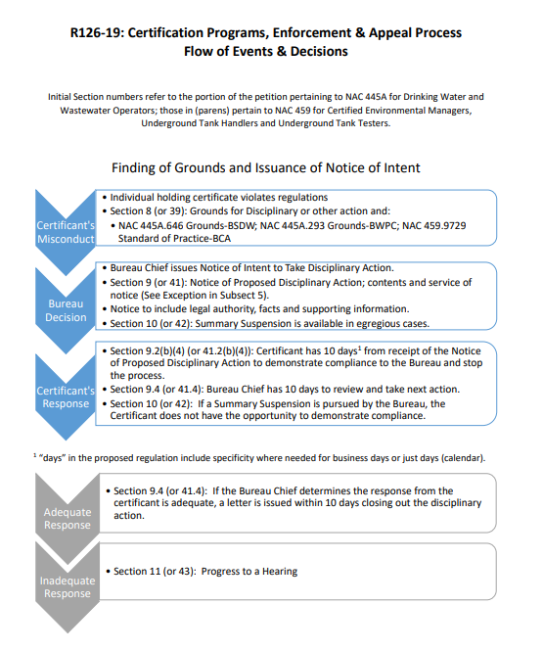

Slide 7
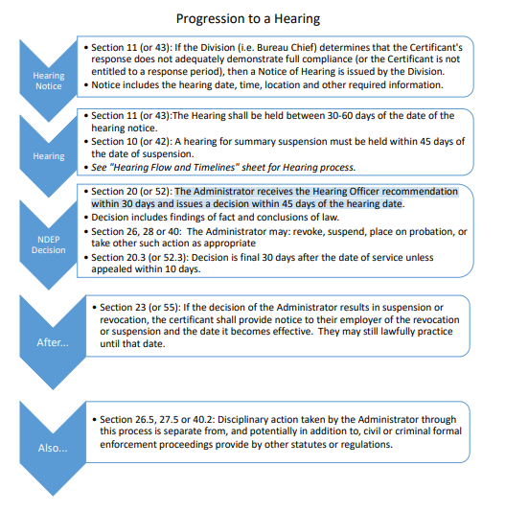

Slide 8
Disciplinary Matrix

Slide 9
Nevada Water Operator Exam Summaries 1st Quarter 2025
NDEP Bureau of Safe Drinking Water
Operator Certification Program

Slide 10
2025 1st Quarter - Distribution
First Quarter 2025 Summary of Distribution OpCert Exams
Distribution | Date | Test | Total | Pass | Fail | % Pass | Low Grade | High Grade | Median | Most Missed
1 | Q1 | Agg | 58 | 44 | 14 | 76% - (4%) | 41 | 94 | 76 | Disinfection MEA & Lab
2 | Q1 | Agg | 31 | 24 | 7 | 77% - (2%) | 58 | 89 | 76 | SSA & Public Interactions
3 | Q1 | Agg | 16 | 12 | 4 | 75% - (1%) | 48 | 90 | 76.5 | System Components
4 | Q1 | Agg | 0 | 0 | 0 | 0%
 |  |  | 105 | 80 | 25 | 76% - (3%)
DISTRIBUTION CATEGORIES:
System Information & Components
Equipment; Install, Operate and Maintain
Monitor, Evaluate & Adjust Disinfection & Lab
Security, Safety, Public Interaction & Administrative Procedures

Slide 11
2025 1st Quarter - Treatment
First Quarter 2025 Summary of Treatment OpCert Exams
Treatment | Date | Test | Total | Pass | Fail | % Pass | Low Grade | High Grade | Median | Most Missed
1 | Q1 | Agg | 22 | 16 | 6 | 73% - (3%) | 57 | 92 | 76.5 | Equipment O&M
2 | Q1 | Agg | 11 | 6 | 5 | 55% - (45%) | 31 | 87 | 75 | Lab
3 | Q1 | Agg | 7 | 6 | 1 | 86% (14%) | 68 | 86 | 81 | Treatment & Lab
4 | Q1 | Agg | 0 |  |  | 0%
 |  |  | 40 | 28 | 12 | 70% - (13%)
TREATMENT CATEGORIES:
Treatment: Monitor, Evaluate and Adjust
Laboratory Analysis
Operate and Maintain Equipment
Evaluate Characteristics of Source Water
Perform Security, Safety & Administrative Procedures

Slide 12
Passing Percentage Trend 2021-2025

Slide 13
Passing Percentage Trend 2021-2025

Slide 14
Passing Percentage Trend 2021-2024

Slide 15
Passing Percentage Trend 2021-2024

Slide 16
NDEP Bureau of Safe Drinking Water
Operator Certification Program
Bureau Chief Andrea Seifert, P.E.
Data Mngmnt / OpCert Supervisor Linh Kieu
Program Manager Carlos Quiroz
Administrative Specialist Rachel Weingart

Slide 17
1) New Training Opportunity for Operators 2) Available Biannually or Quarterly 3) Online – Through TEAMS or Zoom 4) Operators can earn CEUs 5) Nevada Specific 6) First session to occur within the next 3 months 7) Possible first topic: M&R Compliance
NDEP Regulatory Training

Slide 18
Any Suggested/Desired Trainings?
NDEP Regulatory Training

