Slide 1
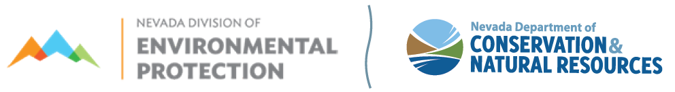
Board for Financing Water Projects
June 26, 2024
9:00 AM
Location:
The Richard H. Bryan Building
Tahoe Hearing Room
901 South Stewart Street, 2nd Floor
Carson City, NV 89701
To Access Virtually
Microsoft TEAMS
Meeting ID: 214 188 114 971; Passcode: ygLuut
Call in from Mobile/Phone (audio only): 1-775-321-6111
Meeting extension: 851250702#

Slide 2


Agenda 2:
Introductions
Jennifer Carr
Administrator
Danilo Dragoni
Deputy Administrator
Jeffrey Kinder
Deputy Administrator
Rick Perdomo
Deputy Administrator
James A. Settelmeyer
Director

Slide 3
Agenda 3:
Public Comment
Jennifer Carr
Administrator
Danilo Dragoni
Deputy Administrator
Jeffrey Kinder
Deputy Administrator
Rick Perdomo
Deputy Administrator
Those wishing to make public comment that are participating remotely may due so by calling in 775-321-6111 and using meeting extension 851250702#, or by raising your hand through the TEAMS module so the moderator may call on you.
Members of the public will be invited to speak before the board; however, no action may be taken on a matter during public comment until the matter itself has been included on an agenda as an item for possible action. Public comment may be limited to three (3) minutes per person at the discretion of the chair. Additional comments may be submitted to the board for inclusion in the minutes.

Slide 4
Jennifer Carr
Administrator
Danilo Dragoni
Deputy Administrator
Jeffrey Kinder
Deputy Administrator
Rick Perdomo
Deputy Administrator
Agenda 4:
Approval of May 15, 2024
Board meeting minutes

Slide 5
Capital Improvements Grant funding update as of June 12, 2024
Agenda
Item
5
Current Cash: $ 6,012,536.10¹
Reserved for Administration: $ 21,400.52
Estimated bond interest earnings: $190,757.95
Committed bond funds not yet disbursed: $ 1,501,231.97
Projects for Consideration: $ 4,674,378.00
Un-committed funds: $ 6,283.56²
¹From all sources including bond proceeds, administration fees, and treasurer’s interest.
²Includes estimated bond interest earnings for remainder of calendar year 2024.

Slide 6
Capital Improvements Grant funding update
as of June 12, 2024
Agenda
Item
5
Activity since bond issuance
Notes:
Agenda Item #16

Slide 7
Capital Improvements Grant funding update
as of June 12, 2024
Agenda
Item
5
Forecasted Activity on bond issuance
Notes:
Agenda Item #16

Slide 8
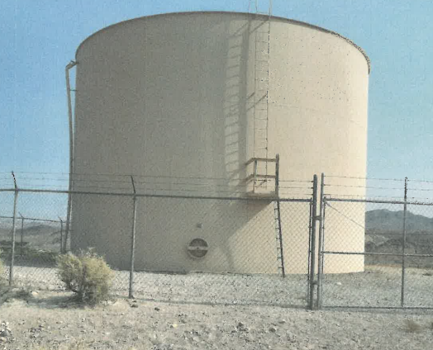
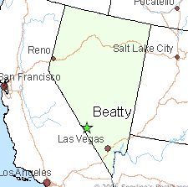
Beatty Water and Sanitation District
66%
Grant eligible
Re-alignment of DWSRF project to Capital Improvement Grant
Amount committed to spend by November 1, 2024 $537,690.91
Reimbursed from Capital Improvements Grant Program $354,876.00
Reimbursed through Drinking Water SRF Contract DW2310 $182,814.91
Notes:
RECAP - The existing Beatty Water System Rehab project has many aspects within it that require improvement ---- With the need to prioritize, initial work has focused on storage tank rehabilitation and the addition of a larger tank to reduce pressure fluctuations and provide a reserve for fire suppression.
The Water Sanitation District has committed to spend $537,000 by November of this year -----With matching, $354,000 will come from Capital Improvement Grant and $182,000 from the existing DWSRF contract.

Slide 9
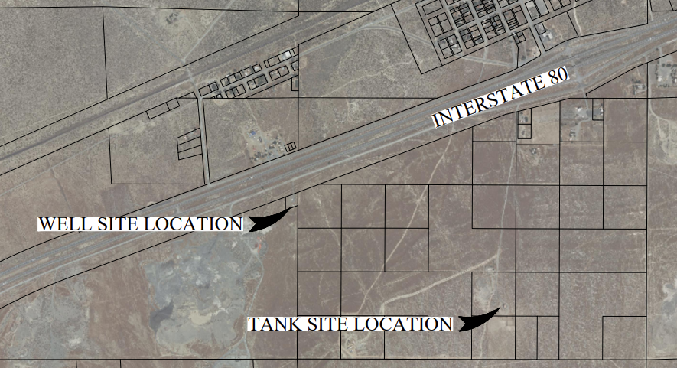
Pershing County
Imlay, NV
67%
Grant eligible
Partial re-alignment of DWSRF project to Capital Improvements Grant
Original funding authorized by D12-0623 (June 28, 2023) | $1,504,800
Increase in electrical costs | $200,000
Modified overall project cost | $1,704,800
Paid by Capital Improvements Grant Program | $550,500
Paid by DW2319 Contract | $1,154,300
Amount committed to spend by November 1, 2024 | $821,641.79
Reimbursed from the Capital Improvements Grant Program | $550,500
Reimbursed from the Drinking Water Contract DW2319 | $271,141.79
Notes:
TO RECAP ------ Our existing Pershing County Imlay NV Project is increasing water storage from 1 to 2 tanks –--- this will satisfy required storage capacity and redundancy for the water system. With the new storage tank in place, the existing tank can be emptied for inspection and rehabilitation. Also, the primary and back-up well pumps and motors will be replaced as they have exceeded their useful life and are insufficient to meet demand.
Our resolution today is recommending an additional $200,000 to meet increased electrical costs that exceeded the original PER estimate. So Overall Project Cost is bumped to $1,700,000 -----reimbursed $550,000 from the Capital Improvement Grant and $1,154,300 with DWSRF.
With this re-alignment the county has commited to spend roughly $821,000 by November of this year -------- reimbursed by $550,500 from Capital Improvement Grant along with system match of $271,000 from the Drinking Water SRF contract .

Slide 10
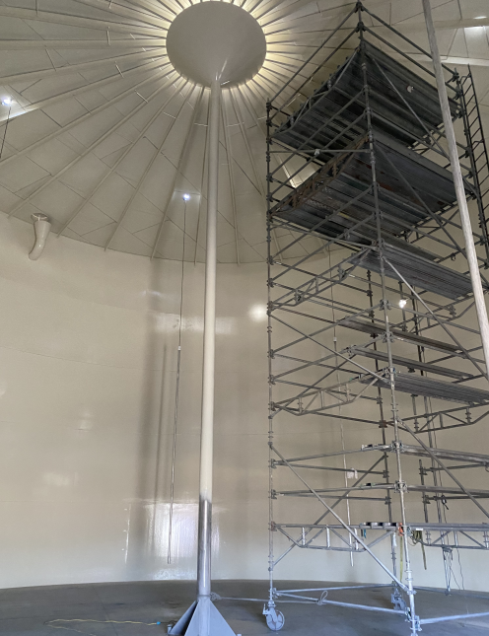
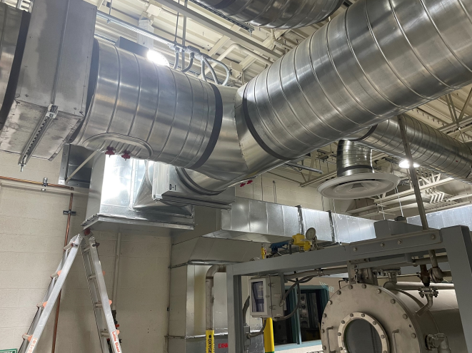
Las Vegas Valley
Water District
(Big Bend)
71% Grant eligible
Original funding authorized | $3,238,000
Increase in costs | $500,000
Modified overall project cost | $3,728,000
Updated Capital Improvement Grant GP2103 (51.3%) | $1,908,622
Updated DWSRF Principal Forgiveness loan DW2108 (48.9%) | $1,829,378
Amount committed to spend by November 1, 2024 | $1,111,726
Reimbursed from the Capital Improvements Grant Program GP2103 | $786,368
Reimbursed from the Drinking Water Contract DW2108 | $325,358

Slide 11
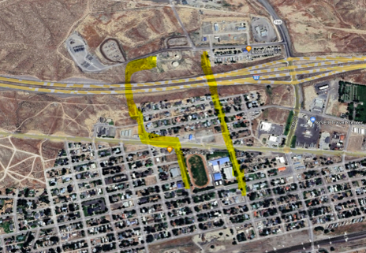
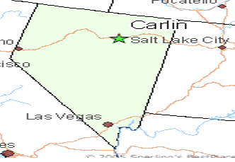
City of Carlin
Replacement of Storage Tank Transmission Lines
DWSRF Priority List
# 67
49% Grant eligible
Total Draws by November 1, 2024 | $3,364,000
Cap Grant Program | $1,648,360
Local Source/USDA Loan | $1,715,640
Notes:
The City of Carlin has a tremendous amount of need on Clean Water and Drinking Water sides of the house. Aging and failing storage tank transmission mains were chosen to initiate what will be multiple phases of a more comprehensive improvements plan.
At #67 on the Drinking Water SRF Priority List the Capital Improvement Grant could not find a more deserving recipient. This will be a partner funding project with USDA Rural Development.
With this resolution, the City of Carlin has committed to spend $1,648,360 provided by the capital improvements grant program by November 1, 2024

Slide 12
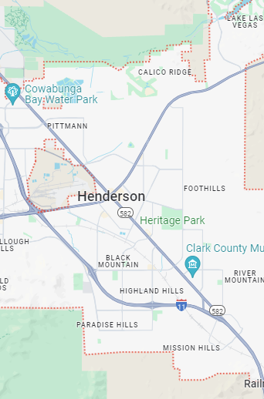
City of Henderson
The existing system is a 23-year-old platform with limited resources available for support/professional services
up-to-date self-service capabilities
efficient and secure operations
44% Grant eligible
Total Draws by November 1, 2024 | $3,850,000
Cap Grant Program | $1,694,000
Local Source | $2,156,000
Notes:
The

Slide 13
Agenda 12:
Changes to the Capital Improvements Grant resolutions
Jennifer Carr
Administrator
Danilo Dragoni
Deputy Administrator
Jeffrey Kinder
Deputy Administrator
Rick Perdomo
Deputy Administrator
James A. Settelmeyer
Director

Slide 14
Agenda 13:
Board Discussion
Jennifer Carr
Administrator
Danilo Dragoni
Deputy Administrator
Jeffrey Kinder
Deputy Administrator
Rick Perdomo
Deputy Administrator
James A. Settelmeyer
Director

Slide 15
Agenda 14:
Public Comment
Jennifer Carr
Administrator
Danilo Dragoni
Deputy Administrator
Jeffrey Kinder
Deputy Administrator
Rick Perdomo
Deputy Administrator
Those wishing to make public comment that are participating remotely may due so by calling in 775-321-6111 and using meeting extension 851250702#, or by raising your hand through the TEAMS module so the moderator may call on you.
Members of the public will be invited to speak before the board; however, no action may be taken on a matter during public comment until the matter itself has been included on an agenda as an item for possible action. Public comment may be limited to three (3) minutes per person at the discretion of the chair. Additional comments may be submitted to the board for inclusion in the minutes.

Slide 16
Future Board Meetings
Status | Date of Meeting | Loan Applications Due Date
Confirmed | Wednesday, June 26, 2024 | N/A
Confirmed | Wednesday, August 21, 2024 | Friday, July 5, 2024
Confirmed | Wednesday, November 13, 2024 | Friday, September 27, 2024
Confirmed | Wednesday, February 19, 2025 | Friday, January 3, 2025
Confirmed | Wednesday, May 21, 2025 | Friday, April 4, 2025
Confirmed | Wednesday, August 20, 2025 | Thursday, July 3, 2025
Confirmed | Wednesday, November 19, 2025 | Friday, October 3, 2025
Notes:
Agenda Item #16

