Slide 1
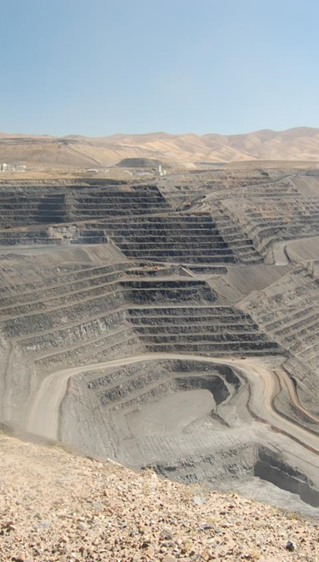







Nevada Division of Environmental Protection
Bureau of Mining Regulation and Reclamation
Database Workshop
May 17, 2021
Presented by:
Christine Olson, Ph.D., Environmental Scientist IV, BMRR
ndep.nv.gov/land/mining l @NevDCNR

Slide 2

LifeSize Video Meeting
Mute button
Raise hand button (Q&A session)

Slide 3
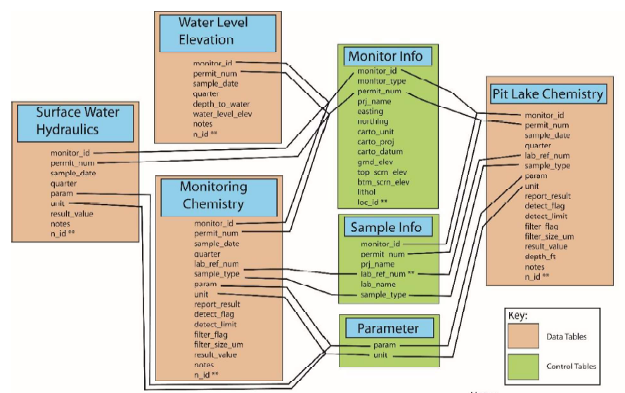
Outline
Slide 1
Part I – Introduction
Part 2 – Proper Formatting
Part 3 - Common Formatting Errors
Part 4 – Unique Data Reporting Cases
Q&A

Slide 4
Outline
Slide 2
Part I – Introduction
Part 2 – Proper Formatting
Part 3 - Common Formatting Errors
Part 4 – Unique Data Reporting Cases
Q&A

Slide 5

Part I - Introduction
Slide 3
Average monitoring locations per mine site: 30
Data points collected per quarter: 70,000-100,000
Quantitative analysis difficult, current system is inefficient
Looking for a way to save time and resources
Notes:
Data will be public – useful for research; future – input directly by operators

Slide 6
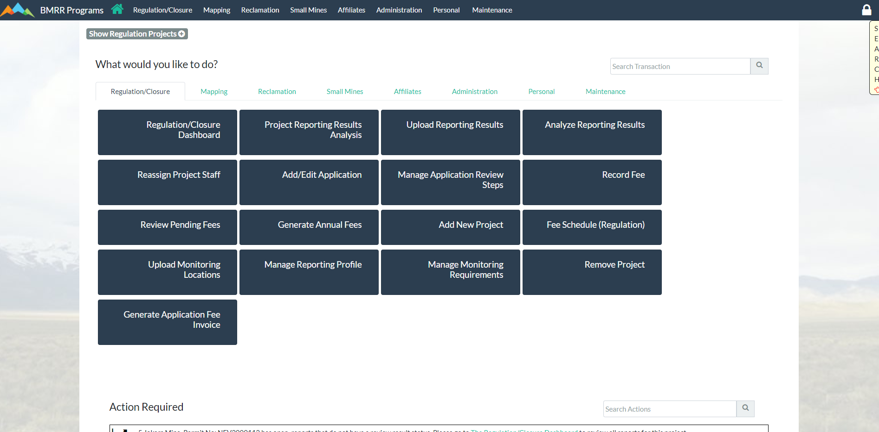
Part I - Introduction
Slide 4

Slide 7
Part I - Introduction
Slide 5
What types of compliance data will the database accept?
Leak detection
Profile I/III
Weather data
Piezometer
E/ET cell
Lysimeters
Ore/waste
Sumps
Surface water Quality
Groundwater Quality
Pit lake data
Soil characterization
Process solution
Closure stability
Static and kinetic tests
UTM coordinates
Lab information

Slide 8
Part I - Introduction
Slide 6
What types of compliance data will the database not accept?
Information not included in the ID Table of the WPCP
Information provided in tables or graphs
PCS (VOCs, SVOCs) related data
Photographs (should be submitted as a pdf)
Kinetic testing data
Lab QA/QC sheets
Narratives of activities or site conditions

Slide 9

Part I - Introduction
Slide 7
New Submittal Requirements
Starting with data collected during the Second Quarter of 2021 (reports due July 28th, 2021), BMR will require the electronic submission of all applicable compliance data in addition to the traditional pdf submission (hard or electronic copy).
Traditional copy will be temporary requirement during transitionary period.
Notes:
anticipated not to exceed one year; Division will notify the Permittees when hard copy monitoring reports are no longer required.

Slide 10
Outline
Slide 8
Part I – Introduction
Part 2 – Proper Formatting
Part 3 - Common Formatting Errors
Part 4 – Unique Data Reporting Cases
Q&A
Notes:
As part of the permitting, active mining, and closure stages, mine operators are required to collect various types of data on an ongoing basis for their water pollution control permits. A large portion of this data include information on both water quality and water quantity in the vicinity of the mine site. These data are used to continually assess the environment surrounding the mine site, and to indicate any possible degradation. Currently, mine operators submit this data to us primarily in paper format. As our program grows and the amount of data increases, this current paper monitoring system is becoming more and more arduous and difficult to manage. My predecessor, Connor Newman started a mine water database to for electronic storage of data; however, we decided to take this system one step further and revamp it to collect not only water quantity and quality data but to store all other monitoring parameters that you will find in your WPCP, which I will cover here in a minute. We believe this database will help us and the operators to save time and resources in the future in ways that I will also explain in the coming slides.

Slide 11
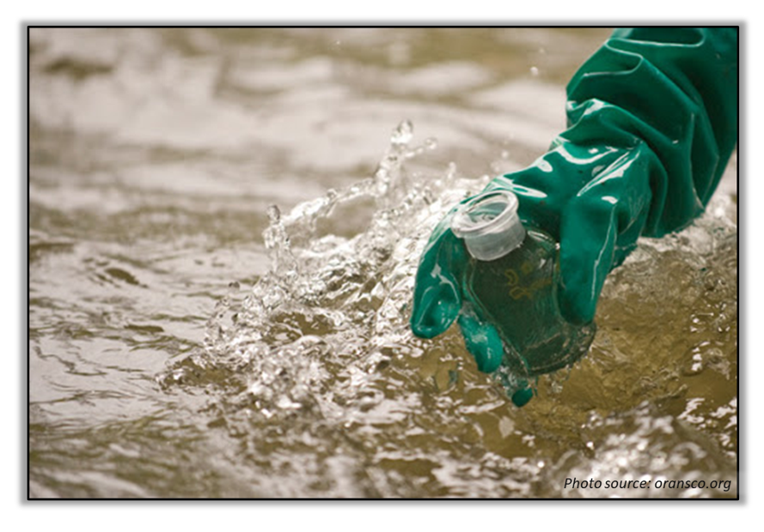
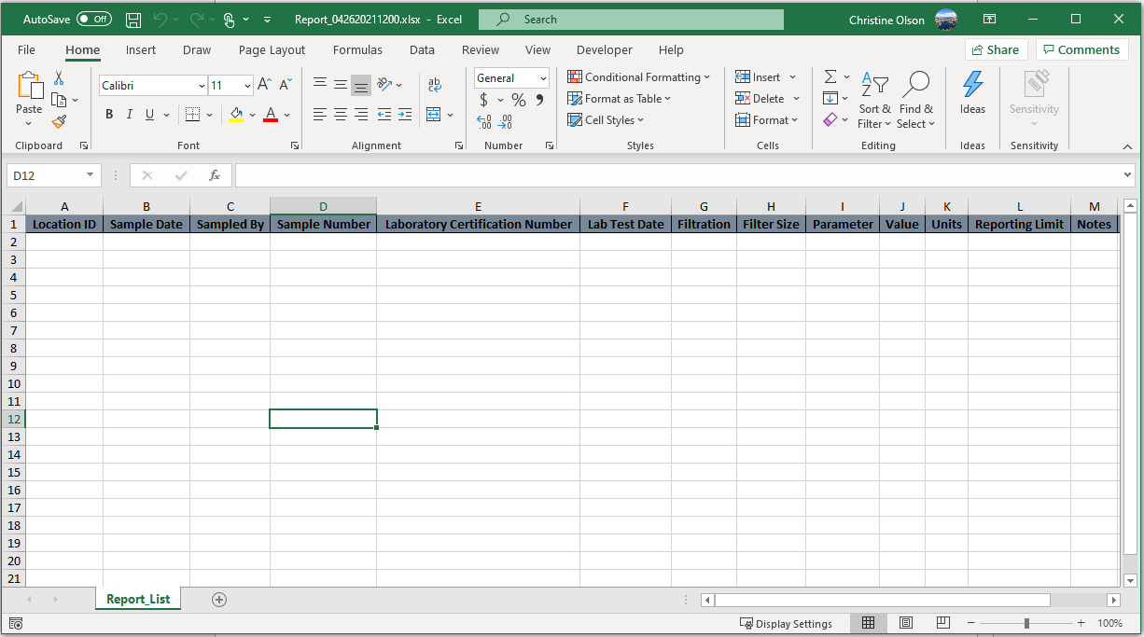
Part 2 – Proper Formatting
Slide 9
Compliance Monitoring Data
Notes:
One or two locations – second tab, many locations – separate spreadsheet

Slide 12
Part 2 – Proper Formatting
Slide 10
General Format Requirements
All compliance data is to be on one sheet and on the first tab of the excel sheet
Please rename file to:
  “NEV00XXXXX_Quarter_X_20XX” (pre-2000)
  “NEV200XXXX _Quarter_X_20XX” (after 2000)
Separate permits into different excel spreadsheets
ALL DATA

Slide 13
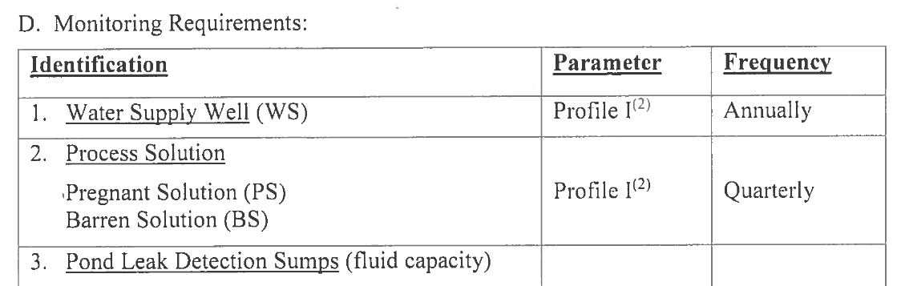
Part 2 – Proper Formatting
Slide 11
Location ID*
Unique to location
Case-sensitive!
Must match WPCP

Slide 14

Part 2 – Proper Formatting
Slide 12
geoetec.com/field-notes/
Sample Date
Date of sample collection, mm/dd/yyyy
Sampled By
Initials of person who collected sample
Notes:
Repeat for each appropriate row

Slide 15
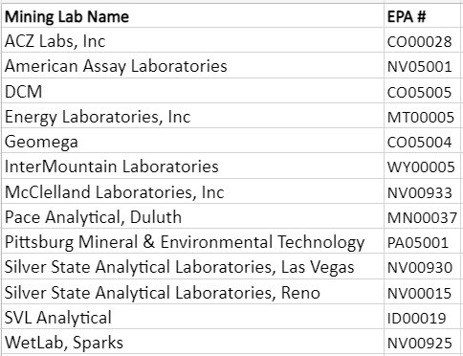
Part 2 – Proper Formatting
Slide 13
Laboratory Certification Number
Unique reference or EPA certification # to track chain-of-custody and other procedures
Lab Test Date
Sample analysis date, mm/dd/yyyy

Slide 16

Part 2 – Proper Formatting
Slide 14
fishersci.com
Filtration
“Filtered” or “Unfiltered”
Filter Size
Size of filter in micrometers, “0.45 µm”

Slide 17
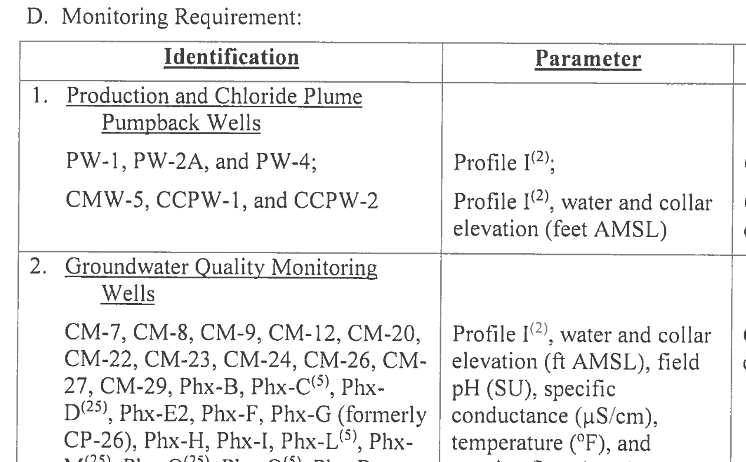
Part 2 – Proper Formatting
Slide 15
Parameter*
Name of reported parameter, e.g., “ANP/AGP”, “Depth of sample”, “Field Temperature”, “Lake area”, “Manganese”, “Pumping rate”, “Volume”
Case sensitive! Refer to Appendix A of “Guidance_for_BMRR_database_upload”
Notes:
If a parameter is not included in the current list, the parameter and corresponding unit of measurement may be added to the database. Please submit such requests to the Division.

Slide 18
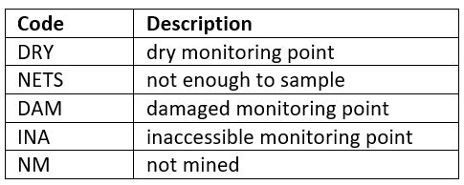
Part 2 – Proper Formatting
Slide 16
Value*
Numerical value for the appropriate sample, parameter, and sample location/date
If below PQL, report using “<“ sign followed by PQL
If sample is missed, use reason code provided in “Guidance_for_BMRR_database_upload”
Notes:
PQL = Practical quantitation limit;

Slide 19

Part 2 – Proper Formatting
Slide 17
Units*
Measurement of unit for Parameter
Case sensitive! Refer to Appendix A of “Guidance_for_BMRR_database_upload”
Reporting Limit
Lab reporting limit for analytical method completed (if applicable)
Notes:
PQL = Practical quantitation limit;

Slide 20

Part 2 – Proper Formatting
Slide 18
Notes
Any additional information on the sample or a text description of the sampling event,
Examples:
  Laboratory flags during analysis
  Continuous depth pit lake sampling
  Waste rock reporting
Notes:
PQL = Practical quantitation limit;

Slide 21
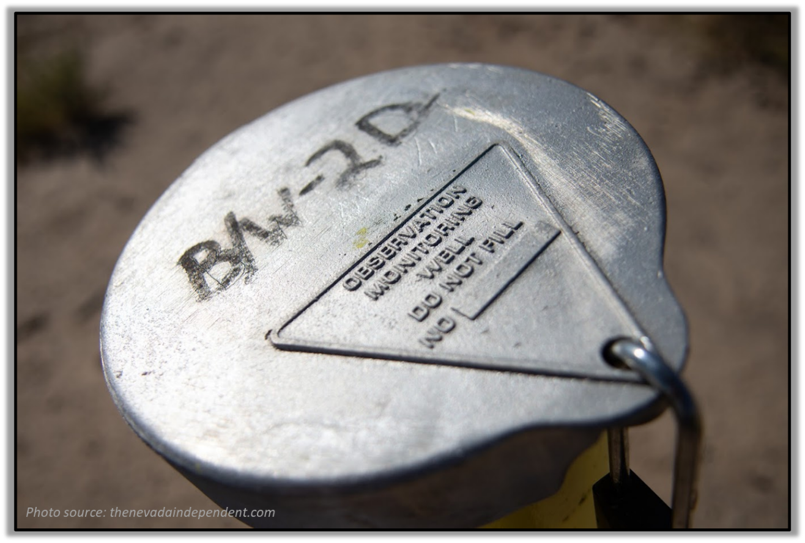
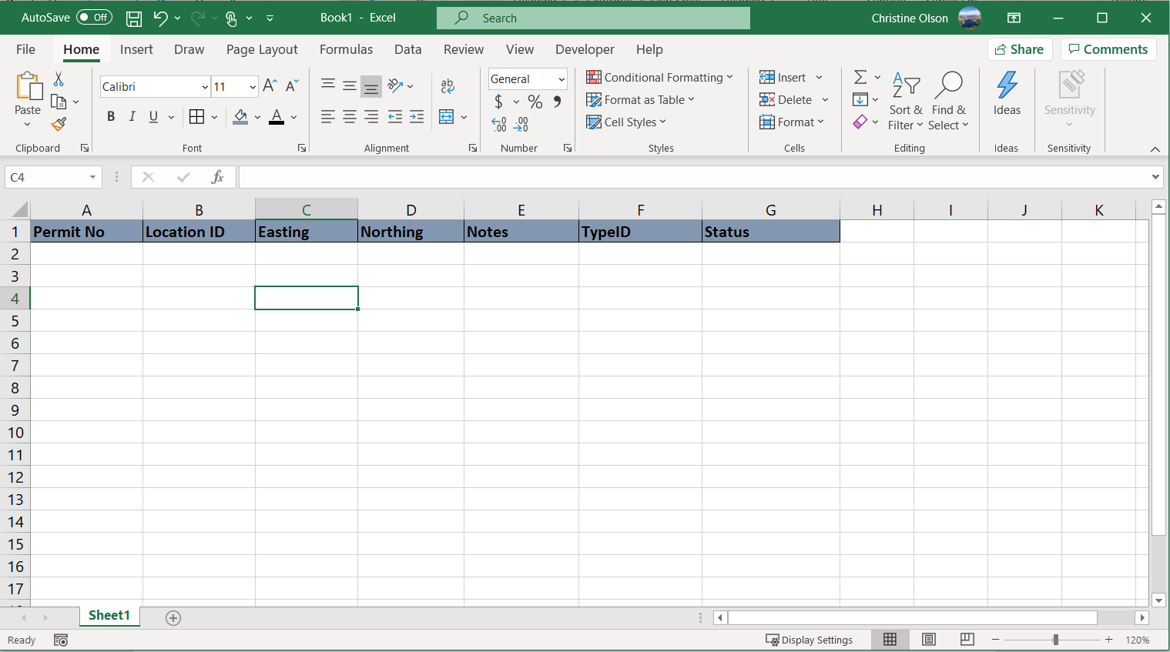
Part 2 – Proper Formatting
Slide 19
Monitoring Location Data

Slide 22
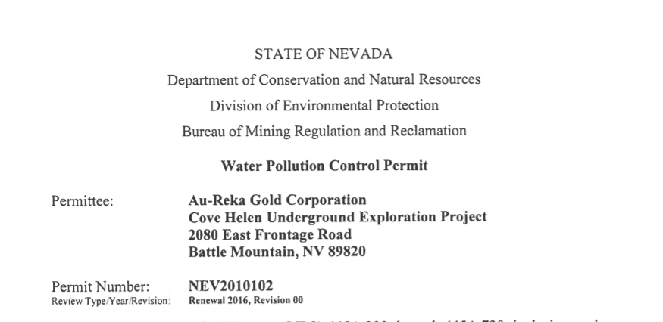
Part 2 – Proper Formatting
Slide 20
Permit No
Water Pollution Control Permit Number, NEVXXXXXX

Slide 23
Part 2 – Proper Formatting
Slide 21
Location ID*
Unique to location
Case-sensitive!
Must match WPCP

Slide 24

Part 2 – Proper Formatting
Slide 22
Easting / Northing
Spatial location of sampling point
Universal Transverse Mercator [UTM], North American Datum [NAD] 1983, Zone 11N, in meters), and accurate to two decimal points (ref. NRS 327.030.b)
  Easting - numeric value between 239650 and 756640
  Northing - numeric value between 3875990 and 4653330

Slide 25
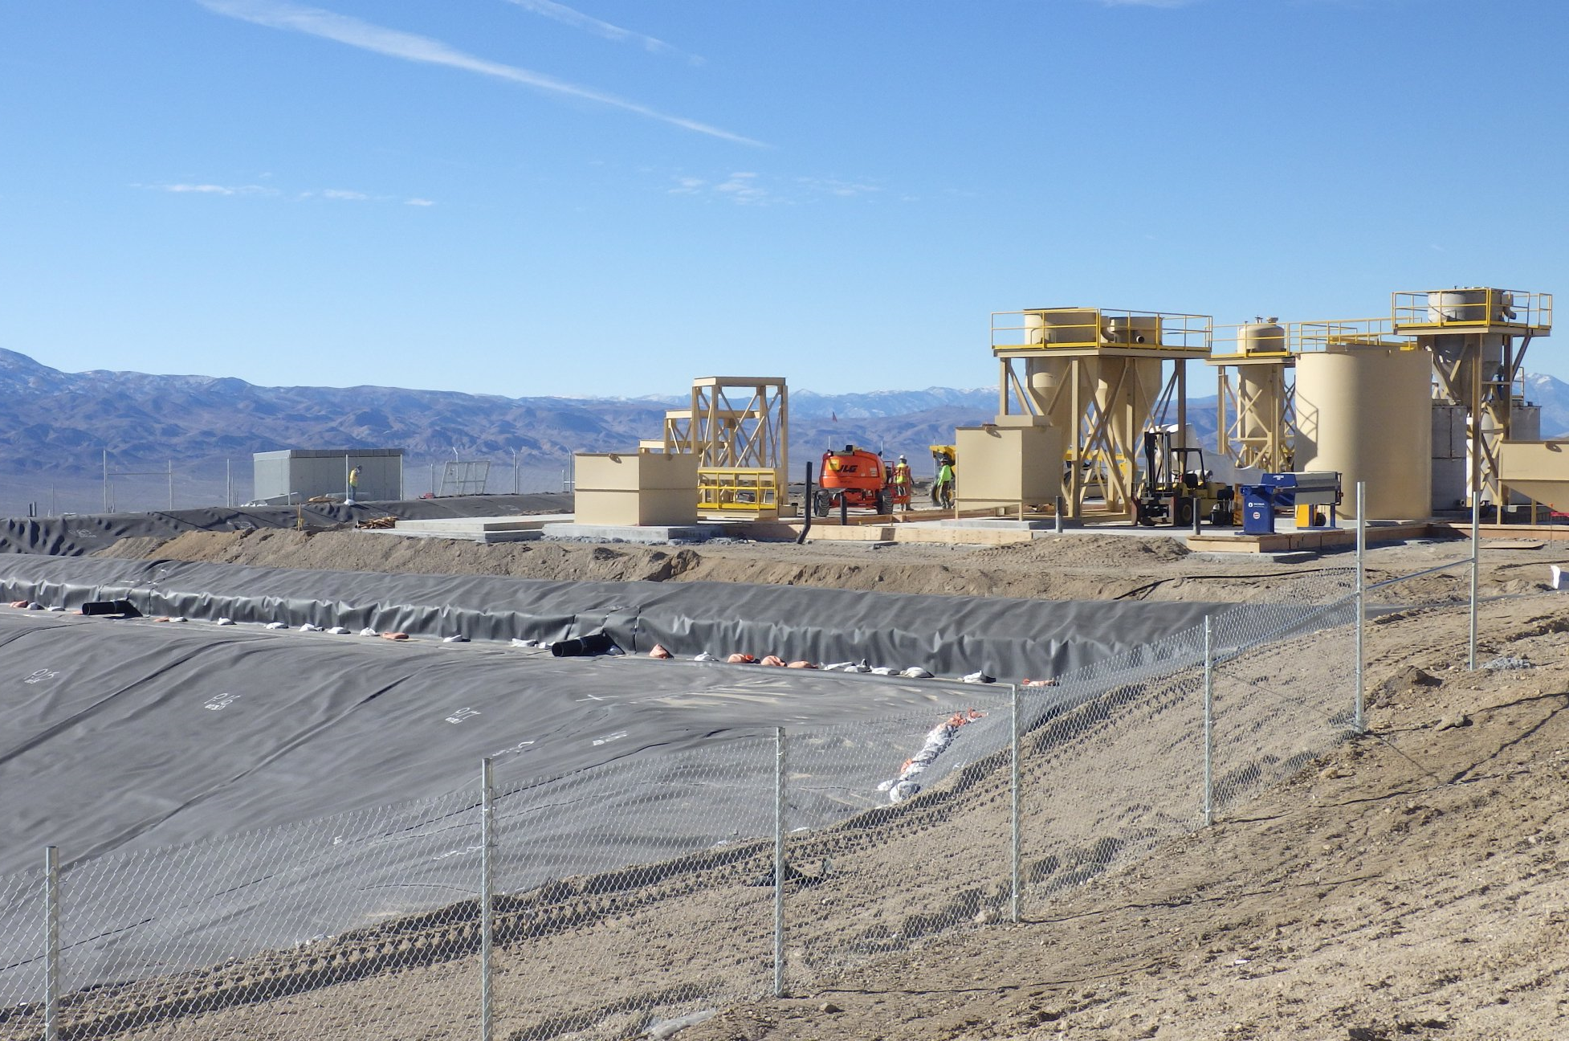
Part 2 – Proper Formatting
Slide 23
Notes
WPCP monitoring location description, e.g., “Upgradient well for HLP”
TypeID
Type of monitoring location – will be filled out by BMRR
Status
“Active”, “Proposed”, “Closed”, or “Inactive”

Slide 26
Outline
Slide 24
Part I – Introduction
Part 2 – Proper Formatting
Part 3 - Common Formatting Errors
Part 4 – Unique Data Reporting Cases
Q&A

Slide 27
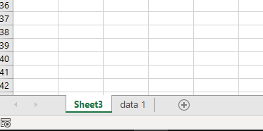
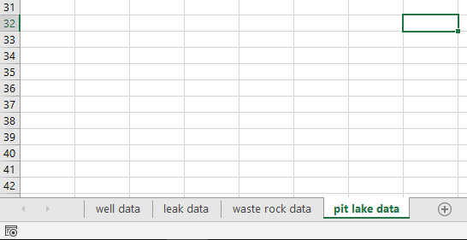
Part 3 – Common Format Errors
Slide 25
X
Error # 1: Compliance data is not in first tab of excel sheet; data on multiple sheets

Slide 28
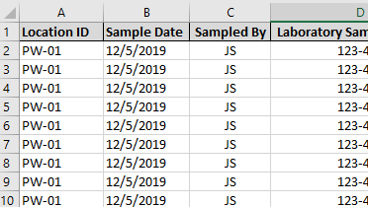
Part 3 – Common Format Errors
Slide 26
X
Error # 2: Location ID syntax does not match unique ID given in permit

Slide 29
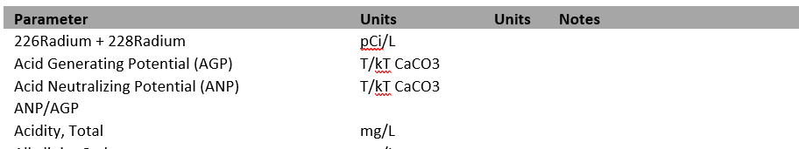
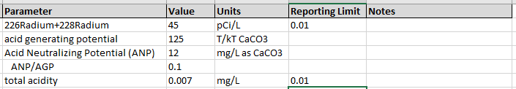
Part 3 – Common Format Errors
Slide 27
X
Error # 3: Parameter or Units do not match Appendix A syntax
Data Provided:

Slide 30
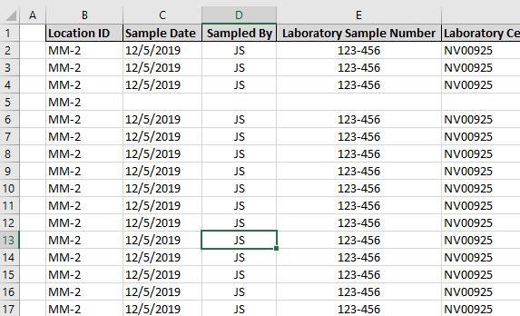
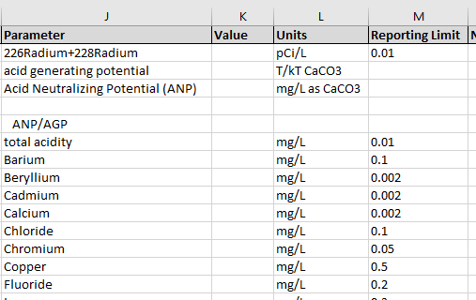
Part 3 – Common Format Errors
Slide 28
X
Error # 4: Blank rows/columns in the upload sheet; reason codes not used

Slide 31
Part 3 – Common Format Errors
Slide 29
X
Error # 4: Blank rows/columns in the upload sheet; reason codes not used

Slide 32
Outline
Slide 30
Part I – Introduction
Part 2 – Proper Formatting
Part 3 - Common Formatting Errors
Part 4 – Unique Data Reporting Cases
Q&A

Slide 33
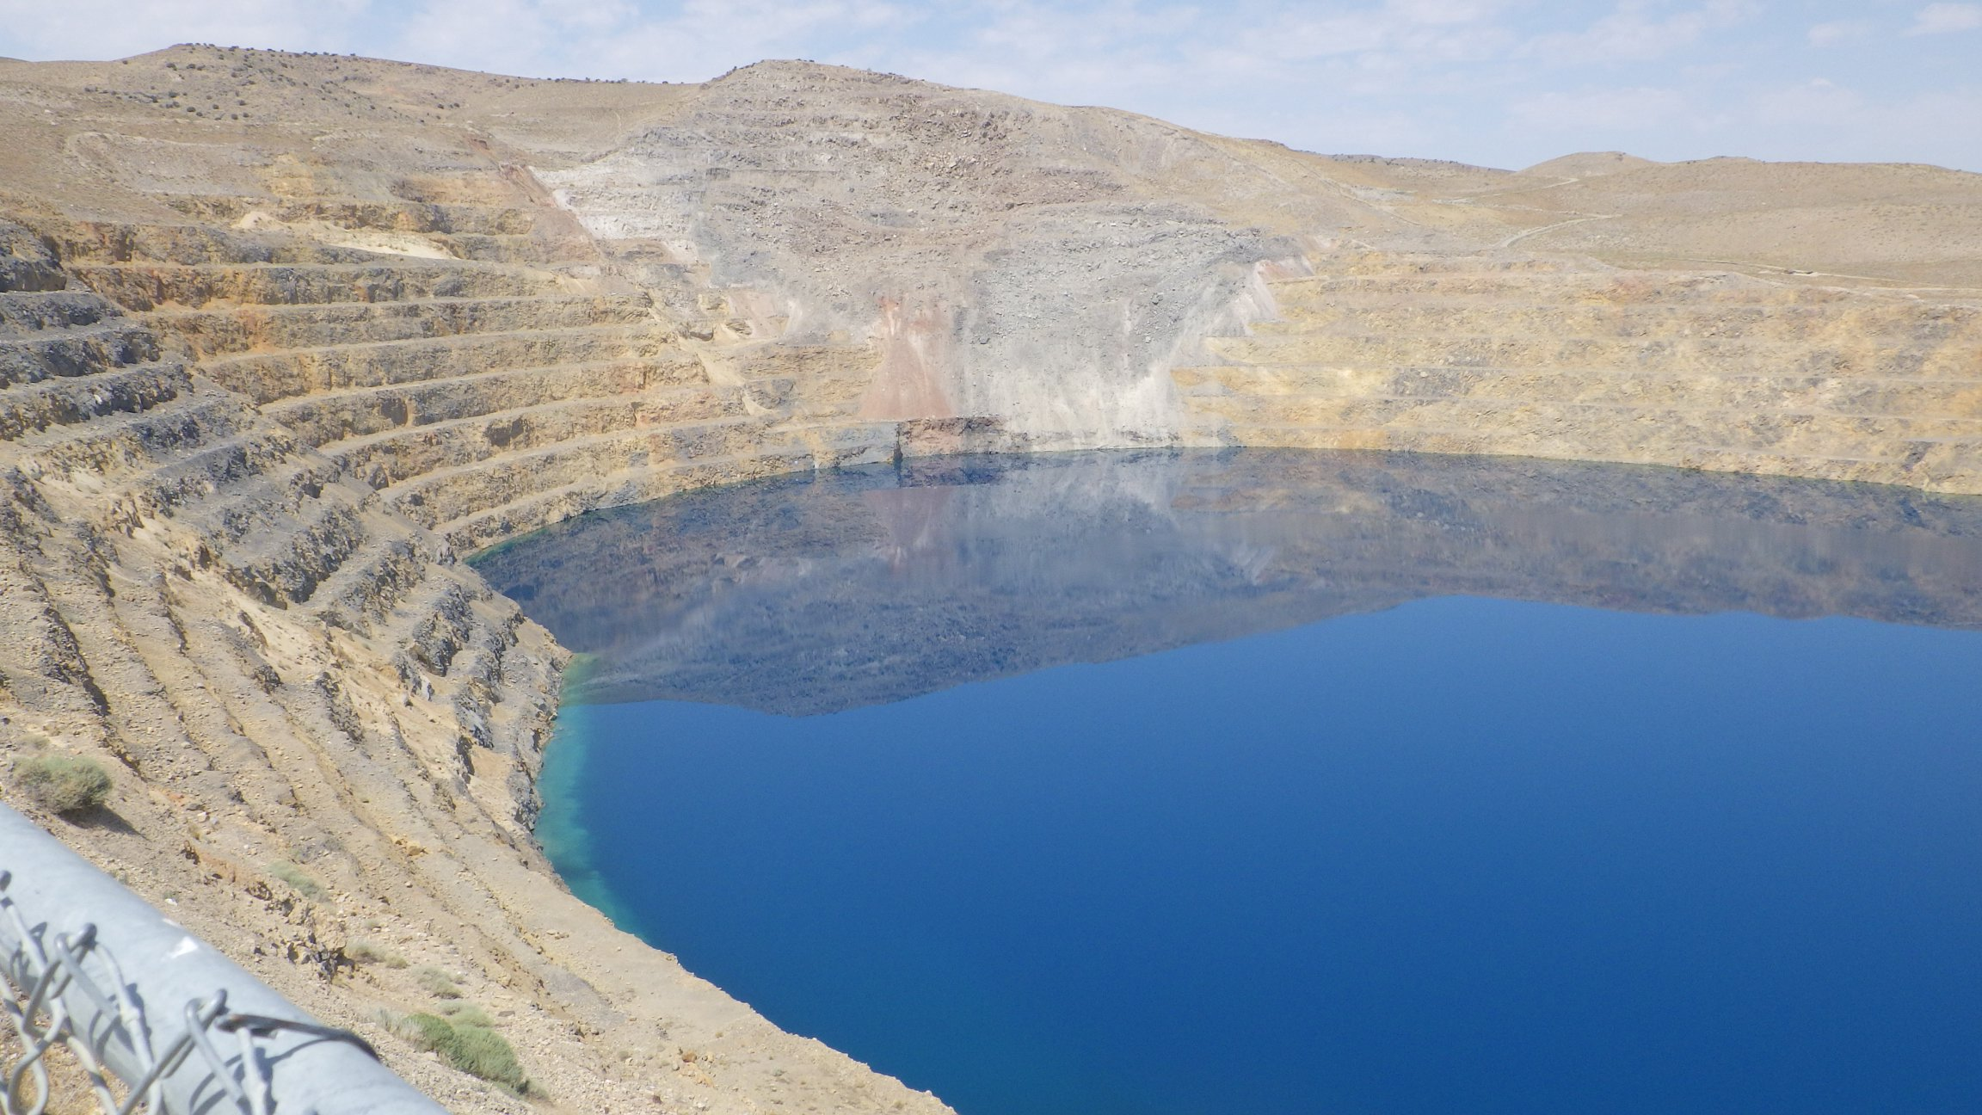
Part 4 – Unique Data Reporting Cases
Slide 31
Pit Lake Reporting
surface, middle, lower reporting
  Option 1: create 3 unique Location IDs*
  Option 2: report location in Notes column
  *consult with permit writer and inspector
Continuous reporting
  report depth in Notes column

Slide 34
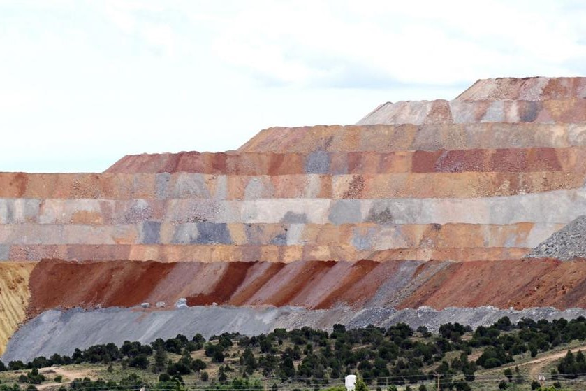
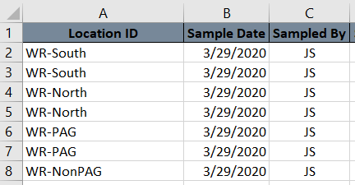
Part 4 – Unique Data Reporting Cases
Slide 32
Waste Rock Reporting
For sites with many reported waste rock types
  Option 1: create a unique Location ID for each type*
  Option 2: report waste rock type in Notes column
  Option 3: report data as a table*
  *consult with permit writer and inspector
Photo Source: Elko Daily Free Press

Slide 35
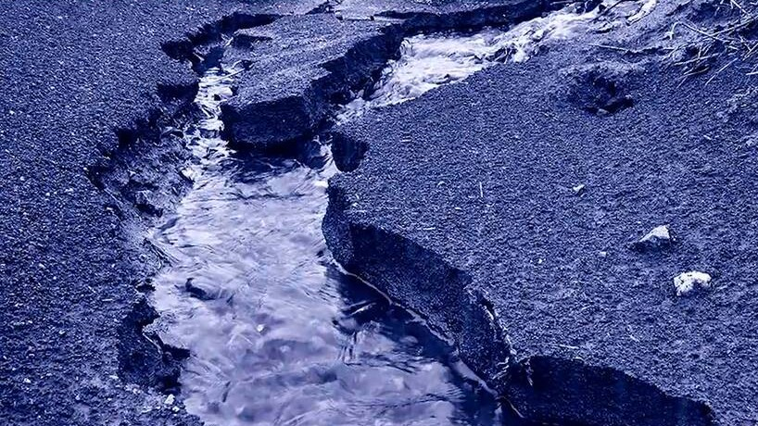
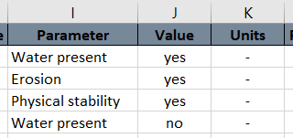
Part 4 – Unique Data Reporting Cases
Slide 33
Unique Parameters and Units
Parameter “Erosion”
Parameter “Water present”
Parameter “Physical instability”
  Use “-” in Units column
  Use “Yes” or “No” in Value column
Photo Source: study.com

Slide 36
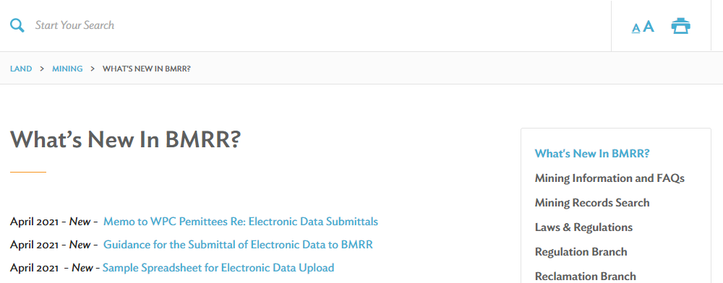
Closing Comments
Slide 34
Link to workshop slides and recording on NDEP’s website
https://ndep.nv.gov/land/mining/whats-new
Also, Link to Guidance Document and Sample Spreadsheet

Slide 37

LifeSize Video Meeting
Slide 35
Please use “raise hand” button to ask a question. We will call on your name and unmute you once it is your turn to speak.

Slide 38

Thanks for your attention!
Questions?

