Slide 1
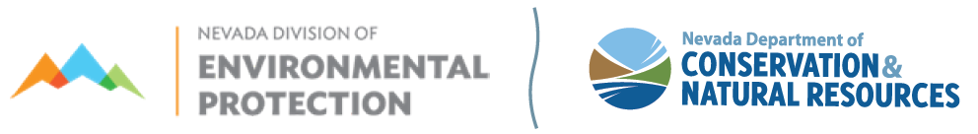
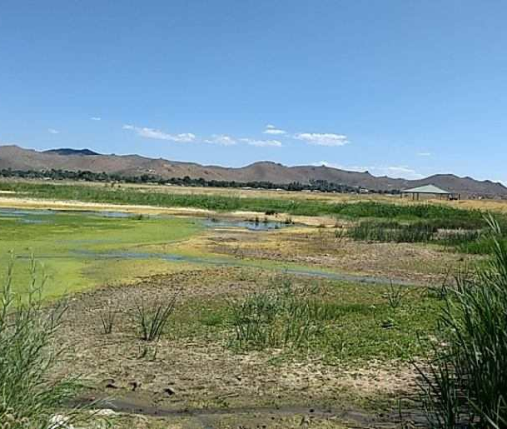


Bureau of Water Pollution Control –Proposed Fee Updates- Workshop
Elizabeth Kingsland, ESIV
Brandon Beach, Management Analyst
NDEP/October 13, 2022
Cover photo –
choose an inviting image that’s on-brand and draws audience in; should represent the “big picture” of presentation topic
- 3.5 inches -
Picture – use thin
white frame
ndep.nv.gov
Notes:
Provide posting locations and notifications that the meeting is being recorded, we are seeking comments from the public on proposed fee increases found in the Water Pollution Control regulations in 445A. Fees under the Water Pollution Control regulations covers all permits for any discharge to waters of the state…includes both surface and ground water.

Slide 2


Who is the Bureau of Water Pollution Control?
Greg Lovato
Administrator
Jennifer Carr
Deputy Administrator
Jeffrey Kinder
Deputy Administrator
Rick Perdomo
Deputy Administrator
The Bureau of Water Pollution Control (BWPC) is charged with protecting the waters of the state from pollution.
The BWPC protects water of the state by:
  Issuing Permits
  Technical Assistance
  Enforcement of State Water Pollution Control Law and Regulations
Authority:
  NRS 445A.300-.730
  NAC 445A.070-.302
James R. Lawrence
Acting Director

Slide 3

Why are fee increases being proposed?
The Bureau of Water Pollution Control collects application fees and annual fees for temporary and individual permits for discharges to the environment.
The BWPC collects fees for temporary and individual permits for direct injection through the Underground Injection Control Program
The BWPC collects fees for Onsite Sewage Disposal Systems (OSDS)
Fees have not been updated since at least 2010
Program Budget
  Maintain a sustainable budget for existing staff
  Meet permittee needs
  Address audit findings from EPA
Greg Lovato
Administrator
Jennifer Carr
Deputy Administrator
Jeffrey Kinder
Deputy Administrator
Rick Perdomo
Deputy Administrator
James R. Lawrence
Acting Director
anoramic photo

Slide 4
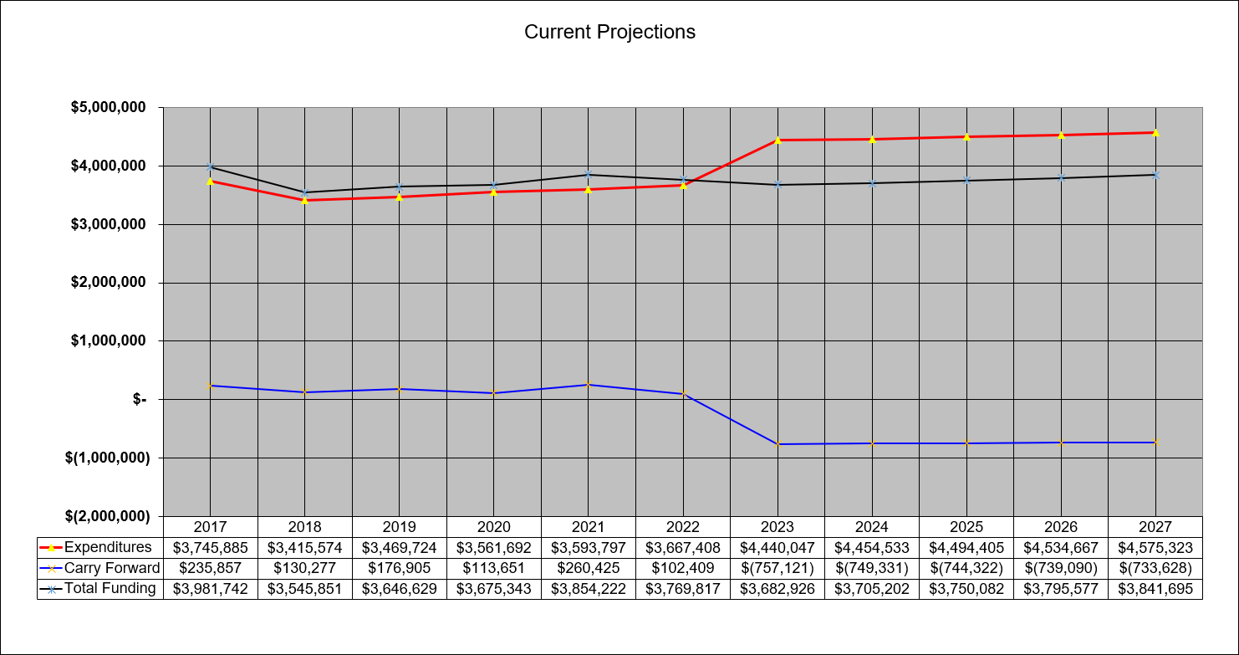
Why are fee increases being proposed?

Slide 5
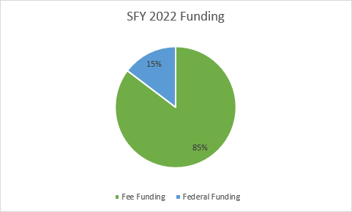
Why are fee increases being proposed?
Greg Lovato
Administrator
Jennifer Carr
Deputy Administrator
Jeffrey Kinder
Deputy Administrator
Rick Perdomo
Deputy Administrator
James R. Lawrence
Acting Director

Slide 6
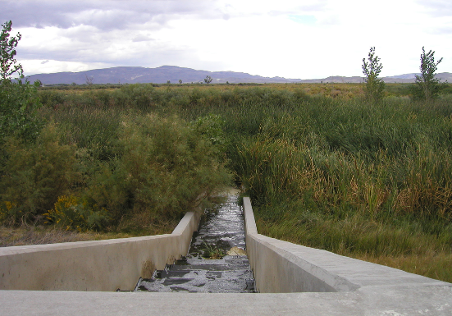
What fees are proposed for increase?
Discharge application/permit fees in NAC 445A.232
Stormwater Permit Fees
Other General Permit Fees
Underground Injection Control
Onsite Sewage Disposal Systems (OSDS)
Greg Lovato
Administrator
Jennifer Carr
Deputy Administrator
Jeffrey Kinder
Deputy Administrator
Rick Perdomo
Deputy Administrator
James R. Lawrence
Acting Director
Sample photo box

Slide 7
Proposed Fees-NAC 445A.232
NAC 445A.232(1) – Discharge Fees
  Annual fees were last evaluated in 2001; fee increases occurred July 1, 2002-July 1, 2010 (NAC 445A.232(8))
  Fees for “Annual Review and Services” listed within regulation do not display the fee increases provided in NAC 445A.232 (8)
Greg Lovato
Administrator
Jennifer Carr
Deputy Administrator
Jeffrey Kinder
Deputy Administrator
Rick Perdomo
Deputy Administrator
8. On July 1, 2002, and on July 1 of each even-numbered year thereafter, up to and including July 1, 2010, the Director shall increase by 5 percent each fee for the annual review and services set forth in subsection 1. To determine the amount of each fee that is due on or after July 1, 2002, the Director shall multiply the fee set forth in subsection 1 by:
(a) For the fees due on July 1, 2002, and July 1, 2003, 1.05;
(b) For the fees due on July 1, 2004, and July 1, 2005, 1.1025;
(c) For the fees due on July 1, 2006, and July 1, 2007, 1.1576;
(d) For the fees due on July 1, 2008, and July 1, 2009, 1.2155; and
(e) For the fees due on or after July 1, 2010, 1.2763.
Ê In establishing the annual fee for the review and services pursuant to this subsection, the Director shall round to the nearest dollar.
James R. Lawrence
Acting Director
Notes:
Fees for Stormwater were not changed in the R206-99 regulation petition so they are even older than the ones in 232 (1). Do we want the exact date of those or just say greater than 12 years ago?

Slide 8
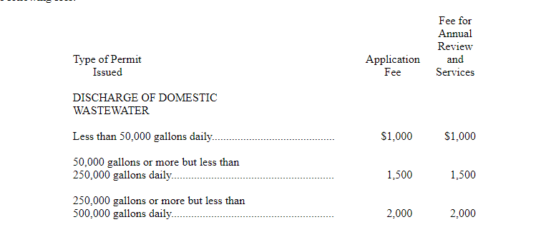
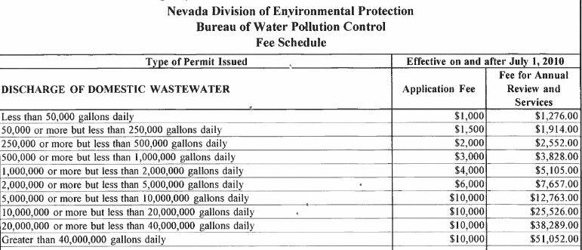
Proposed
Discharge Fees- NAC 445A.232 (cont)
Sample
photo box
Sample
photo box
Sample
photo box

Slide 9
Proposed Fee Changes NAC 445A.232
NAC 445A.232(1) – Proposed based on US Bureau of Labor Statistics- Consumer Price Index
  Annual Review Fee-10.33% increase on July 1, 2023
  Annual Review Fee-10.33% increase on July 1, 2024
  Annual Review Fee 10.33% on July 1, 2025
  Starting July 1, 2026- Application Fees and Annual Review and Services fees- 3% at the start of each fiscal thereafter. During any fiscal year, the Director may suspend the 3% fee increase
Greg Lovato
Administrator
Jennifer Carr
Deputy Administrator
Jeffrey Kinder
Deputy Administrator
Rick Perdomo
Deputy Administrator
James R. Lawrence
Acting Director

Slide 10
Temporary and Minor Modification Application- NAC 445A.232 Proposed Fees
Greg Lovato
Administrator
Jennifer Carr
Deputy Administrator
Jeffrey Kinder
Deputy Administrator
Rick Perdomo
Deputy Administrator
NAC 445A.232(2) –
  Temporary Permits: Existing $250 and Proposed $350
  Minor Modification Permits: Existing (no fee) and Proposed $150
  Starting in July 1, 2026- Increase in Application Fees by 3% at the start of each fiscal thereafter. During any fiscal year, the Director may suspend the 3% fee increase
James R. Lawrence
Acting Director
Notes:
Fees for Stormwater were not changed in the R206-99 regulation petition so they are even older than the ones in 232 (1). Do we want the exact date of those or just say greater than 12 years ago?

Slide 11
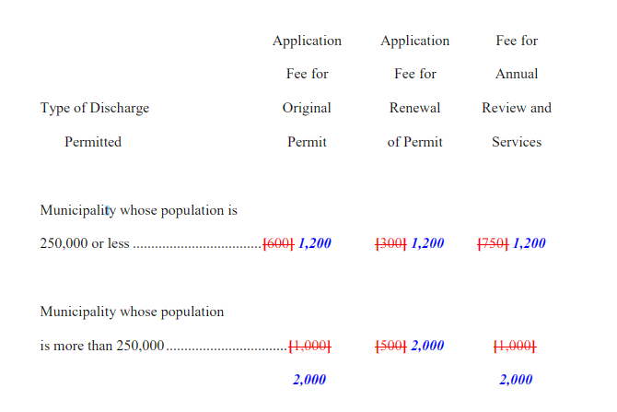
Proposed Fee Changes
NAC 445A.232(2) – Proposed- Municipal Separate Storm Sewer System (MS4) fees
  Proposed increases in Application fees, renewal fees and annual fees
  Starting July 1, 2026, Application Fees, Renewal Fees and Annual Review and Services fees- 3% at the start of each fiscal thereafter. During any fiscal year, the Director may suspend the 3% fee increase
Greg Lovato
Administrator
Jennifer Carr
Deputy Administrator
Jeffrey Kinder
Deputy Administrator
Rick Perdomo
Deputy Administrator
App Fee Renewal Fee Annual Fee
James R. Lawrence
Acting Director
Sample
photo box
Notes:
Fees for Stormwater were not changed in the R206-99 regulation petition so they are even older than the ones in 232 (1). Do we want the exact date of those or just say greater than 12 years ago?

Slide 12
Proposed Fee Changes
NAC 445A.232(2) –Stormwater General Permits
  Existing Application and Annual fees=$200
  Construction Stormwater Proposed:
Construction storm water general permits
Less than 10 acres .................................................................. $300 $200
10 acres or more but less than 50 acres ................................. $400 $200
50 acres or more but less than 100 acres ............................... $750 $400
100 acres or more but less than 500 acres ............................. $1,000 $400
500 acres or more ................................................................... $1,250 $400
App Fee Annual Fee
Notes:
Fees for Stormwater were not changed in the R206-99 regulation petition so they are even older than the ones in 232 (1). Do we want the exact date of those or just say greater than 12 years ago?

Slide 13
Proposed Fee Changes
NAC 445A.232 – Proposed- General Stormwater Permit Fees/Other General Permits
  Existing Application and Annual fees=$200
App Fee Annual Fee
Industrial multi-sector general permit ..................... $1,500 $1,000
Mining storm water general permit ........................... $1,500 $1,000
Other general permits ................................................ $ 300 $ 300
Notes:
Fees were calculated based on hours spent on the initial permit review as well as annual permit renewals. Have to review monitoring reports, etc. Fees for Stormwater were not changed in the R206-99 regulation petition so they are even older than the ones in 232 (1). Do we want the exact date of those or just say greater than 12 years ago? Other general permits will be De Minimis, General Permit for Routine Maintenance Activities, Pesticide Application Program

Slide 14
Proposed Fee Changes
NAC 445A.232 – Proposed- General Stormwater Permit Fees (cont)
  Reinspections and no-exposure waivers
For reinspecting a site that has submitted a notice of termination, $200 per reinspection.
(b) For inspecting a site that is seeking a no exposure certificate, $250.
Starting in July 1, 2026- Application Fees –increase by 3% at the start of each fiscal thereafter. During any fiscal year, the Director may suspend the 3% fee increase
Notes:
Fees were calculated based on hours spent on the initial permit review as well as annual permit renewals. Have to review monitoring reports, etc. Fees for Stormwater were not changed in the R206-99 regulation petition so they are even older than the ones in 232 (1). Do we want the exact date of those or just say greater than 12 years ago? Other general permits will be De Minimis, General Permit for Routine Maintenance Activities, Pesticide Application Program

Slide 15
Proposed Fee Changes
Greg Lovato
Administrator
Jennifer Carr
Deputy Administrator
Jeffrey Kinder
Deputy Administrator
Rick Perdomo
Deputy Administrator
NAC 445A.872 – Proposed- Underground Injection Control
  Clean up
  Addition of a Minor Modification Fee of $150
  Starting July 1, 2026, Application Fees and Annual Review and Services fees- 3% at the start of each fiscal thereafter. During any fiscal year, the Director may suspend the 3% fee increase.
James R. Lawrence
Acting Director
Notes:
Fees for Stormwater were not changed in the R206-99 regulation petition so they are even older than the ones in 232 (1). Do we want the exact date of those or just say greater than 12 years ago? Fees for septic systems are listed elsewhere in the regulation so the duplication here was deleted

Slide 16
Proposed Fee Changes
NAC 445A.963 – Proposed- Onsite Sewage Disposal Systems (OSDS)
  Increase in one-time application fee to construct or make major modifications for <5,000 gallon system from $200 to $400
  Creation of an annual renewal fee for a system less than <5,000 gallons =$150
  Creation of a new fee to add an existing <5,000 gallon system to a general permit =$150
Greg Lovato
Administrator
Jennifer Carr
Deputy Administrator
Jeffrey Kinder
Deputy Administrator
Rick Perdomo
Deputy Administrator
James R. Lawrence
Acting Director
Notes:
Fees for Stormwater were not changed in the R206-99 regulation petition so they are even older than the ones in 232 (1). Do we want the exact date of those or just say greater than 12 years ago?

Slide 17
Proposed Fee Changes
Greg Lovato
Administrator
Jennifer Carr
Deputy Administrator
Jeffrey Kinder
Deputy Administrator
Rick Perdomo
Deputy Administrator
NAC 445A.963 – Proposed- Onsite Sewage Disposal Systems (OSDS)
  Addition of a Minor Modification Fee of $150
  Starting July 1, 2026, Application Fees and Annual Review and Services fees- 3% at the start of each fiscal thereafter. During any fiscal year, the Director may suspend the 3% fee increase.
James R. Lawrence
Acting Director
Notes:
Fees for Stormwater were not changed in the R206-99 regulation petition so they are even older than the ones in 232 (1). Do we want the exact date of those or just say greater than 12 years ago?

Slide 18
How were the proposed fees developed?
Greg Lovato
Administrator
Jennifer Carr
Deputy Administrator
Jeffrey Kinder
Deputy Administrator
Rick Perdomo
Deputy Administrator
Two Methods
Consumer Price Index
Cost Recovery Calculations
James R. Lawrence
Acting Director

Slide 19
Small Business Statement
Impacts on Small Business are not anticipated
  No restriction on formation, operation, expansion of a small business
    Majority of fee increases tied to Consumer Price Index
    Implemented over a 3-year time frame
    Small permit fees are tied to the agency cost recovery
    Looking for additional feedback during this workshop and also until October 18, 2022
Brandon Beach, Management Analyst, BWPC-NDEP
bbeach@ndep.nv.gov
Greg Lovato
Administrator
Jennifer Carr
Deputy Administrator
Jeffrey Kinder
Deputy Administrator
Rick Perdomo
Deputy Administrator
James R. Lawrence
Acting Director
Notes:
Some of the smaller fees may not fully cover the costs but we have attempted to be sensitive to permitees in those sectors and strive to keep our program affordable for them while trying to cover some agency costs. Some funding is provided through federal sources which helps provide the offset. If needed, will have information from Katrina/Bri on how much increased fees could raise fees for their customers (based on number of folks served by the facility).

Slide 20
Schedule
October 18, 2022- final date written comments accepted on the proposed regulation
November 12, 2022 Final proposal to be posted to the State Environmental Commission website
December 14, 2022- Proposed regulation updates to the State Environmental Commission Meeting
Written Comments:
Brandon Beach, Management Analyst, BWPC-NDEP
775-687-9421
bbeach@ndep.nv.gov
Greg Lovato
Administrator
Jennifer Carr
Deputy Administrator
Jeffrey Kinder
Deputy Administrator
Rick Perdomo
Deputy Administrator
James R. Lawrence
Acting Director
Notes:
Some of the smaller fees may not fully cover the costs but we have attempted to be sensitive to permitees in those sectors and strive to keep our program affordable for them while trying to cover some agency costs. Some funding is provided through federal sources which helps provide the offset. If needed, will have information from Katrina/Bri on how much increased fees could raise fees for their customers (based on number of folks served by the facility).

Slide 21
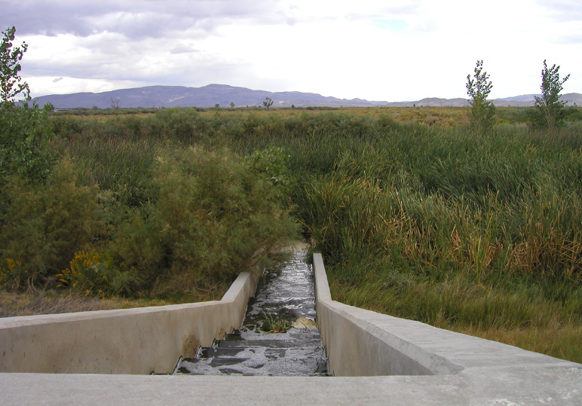
Questions?
Greg Lovato
Administrator
Jennifer Carr
Deputy Administrator
Jeffrey Kinder
Deputy Administrator
Rick Perdomo
Deputy Administrator
James R. Lawrence
Acting Director
Contacts:
Brandon Beach, Management Analyst
BWPC-NDEP
775-687-9421
bbeach@ndep.nv.gov
Elizabeth Kingsland, ESIV
NDEP
775-687-9357
ekingsland@ndep.nv.gov

