Slide 1
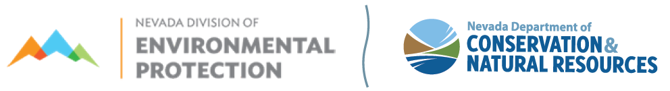
Board for Financing Water Projects
October 5, 2022
9:00 AM
Location:
The Richard H. Bryan Building
Tahoe Hearing Room
901 South Stewart Street, 2nd Floor
Carson City, NV 89701
To Access Virtually
Microsoft TEAMS
Meeting ID: 250 154 648 609; Passcode: wG6jZX
Call in from Mobile/Phone (audio only): 1-775-321-6111
Meeting extension: 903761604#

Slide 2


Agenda 2:
Introductions
Greg Lovato
Administrator
Jennifer Carr
Deputy Administrator
Jeffrey Kinder
Deputy Administrator
Rick Perdomo
Deputy Administrator
James R. Lawrence
Acting Director

Slide 3
Agenda 3:
Public Comment
Greg Lovato
Administrator
Jennifer Carr
Deputy Administrator
Jeffrey Kinder
Deputy Administrator
Rick Perdomo
Deputy Administrator
James R. Lawrence
Acting Director

Slide 4
Greg Lovato
Administrator
Jennifer Carr
Deputy Administrator
Jeffrey Kinder
Deputy Administrator
Rick Perdomo
Deputy Administrator
Agenda 4:
Approval of June 29, 2022
Board meeting minutes
James R. Lawrence
Acting Director

Slide 5
Drinking Water funding update as of September 16, 2022
Cash in fund |  | $83,061,505.95
Less debt service reserves | (6,005,262)
Add undrawn grant balance | 2,615,020.83
Available for projects |  | $79,671,264.78
Committed funds not yet disbursed | 23,931,329.92
Add commitments for Board consideration | 1,370,000.00
Total committed funds after Board approval | $25,301,329.92
Add projects in discussion with NDEP-OFA | 22,275,000.00
Total committed and potential project loans | 47,576,329.92
Lowest cash flow balance in three (3) years | $71,601,008.00
Notes:
Copied from JC’s Word file- SM

Slide 6
Drinking Water Cash Flow Projections¹ as of September 16, 2022
 | Year 1 | Year 2 | Year 3
Cash balance forward | $79,947,863 | $85,838,305 | $85,335,060
Receipts from grants awarded (base) | 4,309,730 | 8,798,880 | 8,798,880
Receipts from Infrastructure Grant awarded (BIL funding) ² | 16,234,140 | 16,650,400 | 17,955,000
Transfer to the CWSRF program ³ | 0 | (30,000,000) | 0
Receipts from bonds issued | 6,000,000 | 5,000,000 | 5,000,000
Receipts from treasurer's interest ⁴ | $802,028 | 865,566 | 994,652
Receipts from loan principal | 13,595,253 | 13,745,873 | 14,262,005
Receipts from loan interest | 3,712,597 | 3,514,473 | 3,169,637
Payments for debt service on bonds | (3,209,150) | (3,045,025) | (2,960,238)
Payments for loan recipients ⁵ | (35,380,431) | (17,241,750) | (8,997,948)
Change in debt service reserves | (173,725) | 1,208,338 | (1,562,913)
Cash balance forward | $85,838,305 | $85,335,060 | $121,994,135
¹Estimate only for planning purposes. All numbers are subject to change.
²BIL funding does not include grants for emerging contaminants or lead service line replacement.
³Transfer to CWSRF is dependent upon budget approval, EPA consent, and program demand
⁴Estimated at 1.0% A.P.R. on undisbursed cash in the fund. Subject to change.
⁵Includes loans not yet approved by the Board for Financing Water Projects
Notes:
Copied from JC’s Word file- SM

Slide 7
Drinking Water funding update as of June 1, 2022
Drinking Water Grant Conditions for Principal Forgiveness
Current funds to obligate for principal forgiveness loans |  | $6,011,553
Less projects for board consideration | $188,000
Less projects in discussion for funding | $5,823,553
Available funds to obligate for principal forgiveness loans after board meeting | $0
Available from the 2022 BIL Supplemental Grant (Application in October with funding in Spring 2023) |  | $10,198,370
Notes:
Copied from JC’s Word file- SM

Slide 8
Drinking Water funding update as of June 1, 2022
Drinking Water Grant Conditions for Principal Forgiveness
Pending Grant Application (Base program only)
*Re-allocation of other state capitalization grants
Notes:
Copied from JC’s Word file- SM

Slide 9
SRF Drinking Water Priority List
Notice of Bypass –Sent August 19, 2022
  Trout Canyon reclassified to Priority #52
Authority
  NAC 445A.67573- Bypass water project on priority list
  NAC 445A.67577 and NAC 445A.67578
Notes:
Copied from JC’s Word file- SM

Slide 10
Program Updates
OFA staffing updates
Administrative Services Officer 3
Accountant 2 (vacant)
Environmental Scientist 4
Professional Engineer
Environmental Scientist 3
Management Analyst 3
Management Analyst 1
Administrative Assistant 3
Notes:
Copied from JC’s Word file- SM

Slide 11
Capital Improvements Grant funding update as of June 1, 2022
Current Cash | $10,210,138.02
Reserved for Administration | $18,714.83
Committed funds not yet disbursed | $10,158,482.11
Projects for Consideration: | $0
Un-committed funds: | $0¹
¹ Includes estimated bond interest earnings for the next 12 months
Notes:
Copied from JC’s Word file- SM

Slide 12
Capital Improvements Grant funding update as of June 1, 2022
Committed funds not yet disbursed:
GP2101 | Lovelock Meadows Water District | Storage Tank 2 rehabilitation | $ 0.00
GP2102 | Churchill County | New well for redundant source requirements | $ 71,797.95
GP2103 | Las Vegas Valley Water District (Big Bend) | Treatment plant improvements; storage rehabilitation; distribution; electrical controls | $ 1,733,980.00
GP2104 | Alamo Sewer and Water GID | Arsenic Treatment | $ 689,526.00
GP2105 | Las Vegas Valley Water District (Blue Diamond) | Pipe replacement, storage, and backup well. | $ 4,200,280.00
GP2201 | Las Vegas Valley Water District (Big Bend) | Phase II Construction | $ 568,000.00
GP2202 | Golconda | Spring Rehabilitation | $ 793,000.00
GP2203 | Topaz Ranch Estates | New Redundant Source | $ 1,645,520.00
Total |  |  | $ 9,702,103.95
Projects for consideration
Total |  |  | $0
Notes:
Copied from JC’s Word file- SM

Slide 13
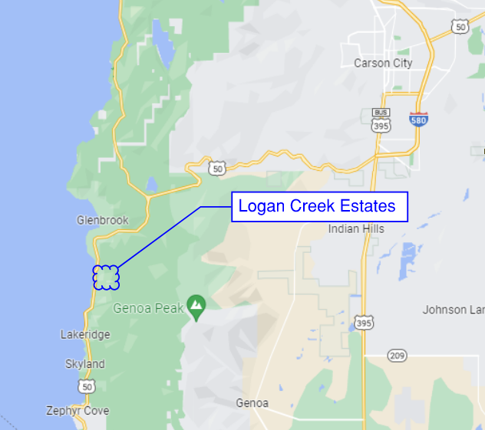
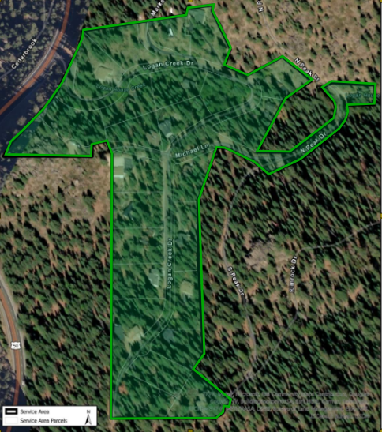
Logan Creek Estates – Additional Storage Tank and New Well - Loan Request
The Logan Creek Estates is a 32-acre residential community in the Lake Tahoe Basin in Douglas County.

Slide 14
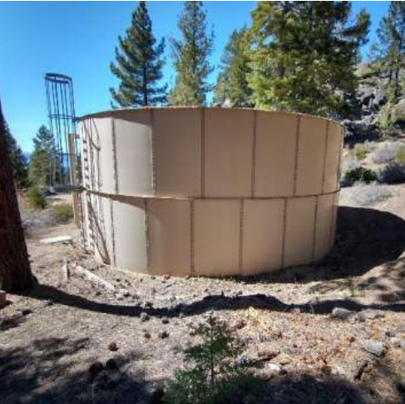
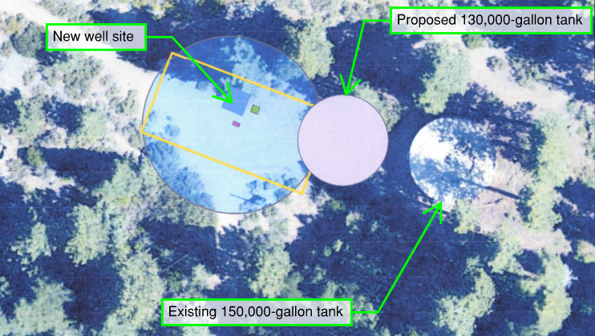
Proposed Project
Construct additional water storage tank adjacent to existing 150,000 gallon water tank to meet operational storage needs and enable existing tank to be removed from service for repairs, relining, and to be improved to meet current standards.
Notes:
Please note that the LCE staff report references the water capacity of 132,000 gallons when referring to the tank size.
Current standards require a guardrail on top of the tank and a silt stop to extend 4-6 inches above floor.

Slide 15
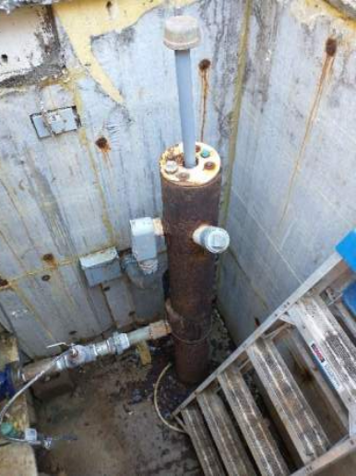
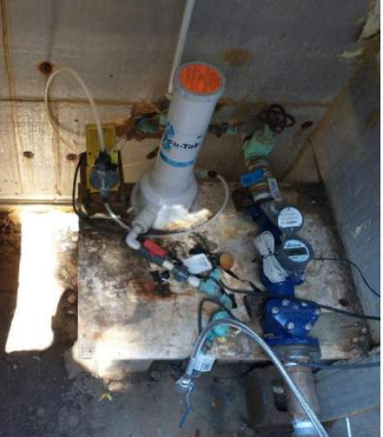
Proposed Project
Install and develop new well at location of the existing Well 3 to build redundance into the system. Modify Well 3 to extend wellhead above grade and to locate electrical components above grade in a well house to meet current standards.

Slide 16
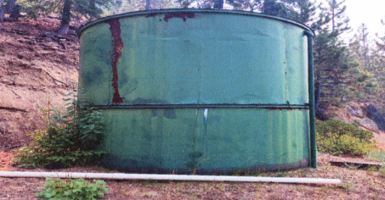
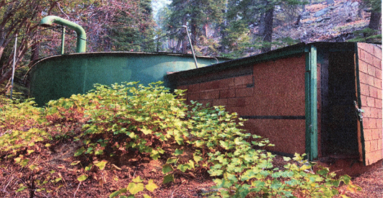
Proposed Project
Environmental Review
United States Forest Service will be the lead on the Environmental Review process. Determination of any historical significance of decommissioned water system components (to be removed by LCE GID with private funding).
Notes:
The environmental review is still in process with the USFS to evaluate environmental, historical and cultural concerns. The Logan Creek GID does need a commitment of funding so they know they have a project to move forward in the process.

Slide 17
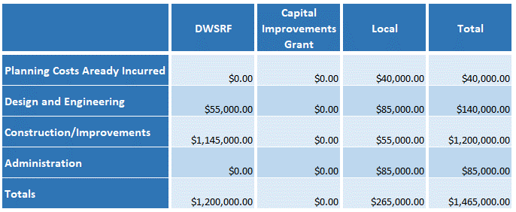
Project Cost Estimates and Funding Sources

Slide 18
Estimated Project Schedule
Design: January – March 2023
Construction Bid/Award March 2023
Construction Completion: November 2024

Slide 19
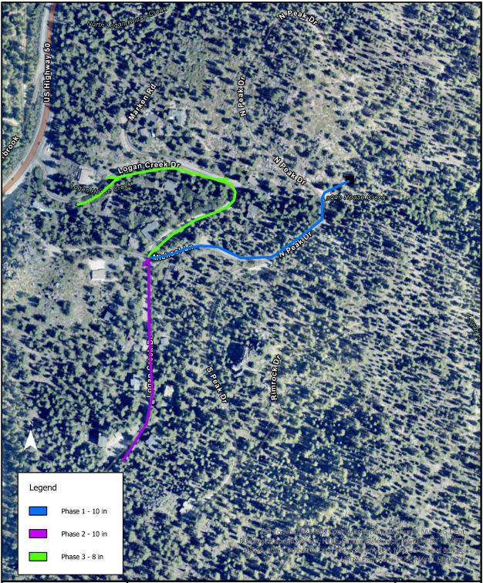
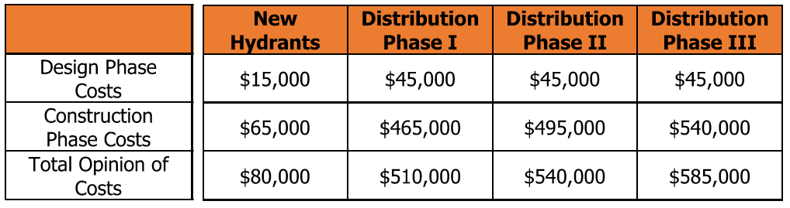
Future Project
A future project will replace the distribution system which is currently 4” Ductile Iron Pipe constructed in 1969. Water meters will be installed with that project.

Slide 20
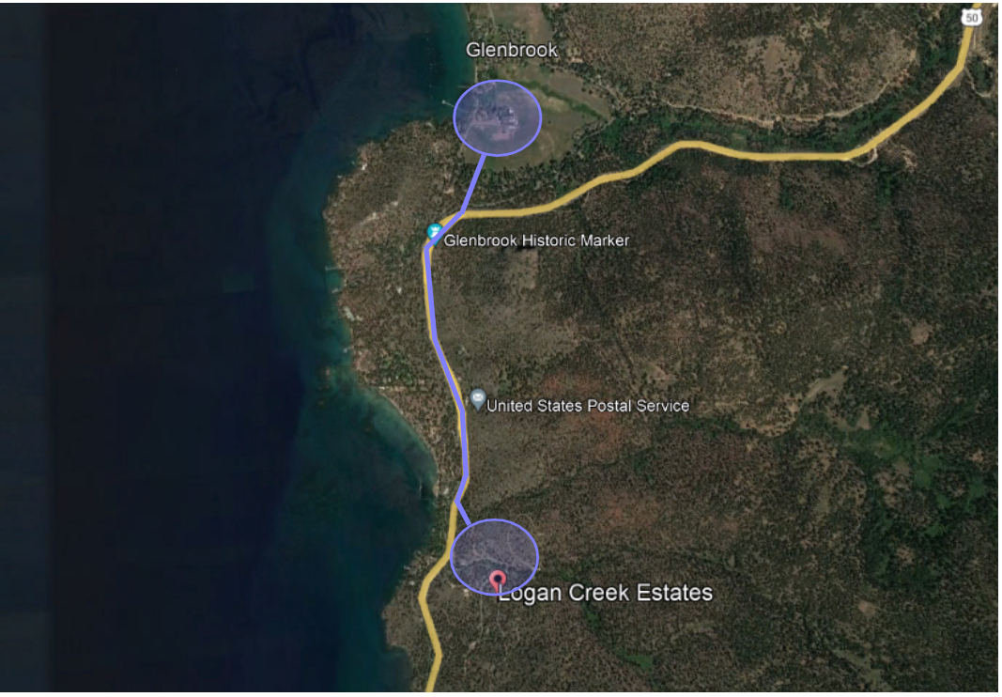
Consolidation
The LCE is in discussion with the Glenbrook Public Water System and NDOT to explore consolidation opportunities during an upcoming NDOT project on US 50. The improvements proposed will be required regardless of the outcome of the consolidation discussions.

Slide 21
Greg Lovato
Administrator
Jennifer Carr
Deputy Administrator
Jeffrey Kinder
Deputy Administrator
Rick Perdomo
Deputy Administrator
Agenda Item 9:
Board Comments
James R. Lawrence
Acting Director
Notes:
Agenda Item #16

Slide 22
Greg Lovato
Administrator
Jennifer Carr
Deputy Administrator
Jeffrey Kinder
Deputy Deputy Administrator
Rick Perdomo
Deputy Administrator
Agenda Item 10:
Public Comments
James R. Lawrence
Acting Director
Notes:
Agenda Item #16

Slide 23
Greg Lovato
Administrator
Jennifer Carr
Deputy Administrator
Jeffrey Kinder
Deputy Deputy Administrator
Rick Perdomo
Deputy Administrator
Agenda Item 11:
Next Board Meeting
Status | Date of Meeting | Loan Applications Due Date
Confirmed | Tuesday, December 6, 2022 | Monday, October 31 ,2022
Proposed | Wednesday, March 22, 2023 | Friday, February 3, 2023
Proposed | Wednesday, June 28, 2023 | Friday, May 12, 2023
James R. Lawrence
Acting Director
Notes:
Agenda Item #16

Slide 24
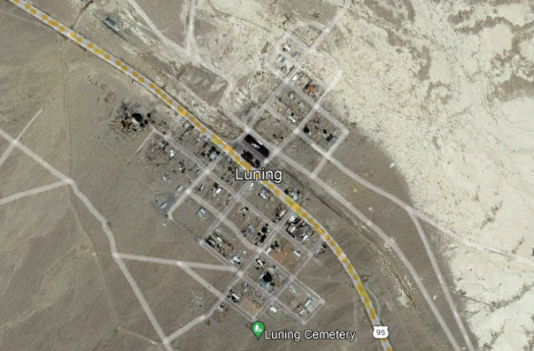
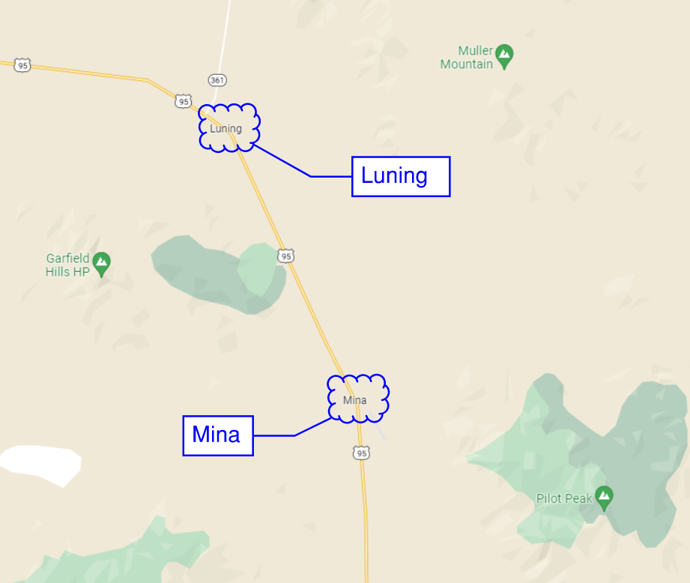
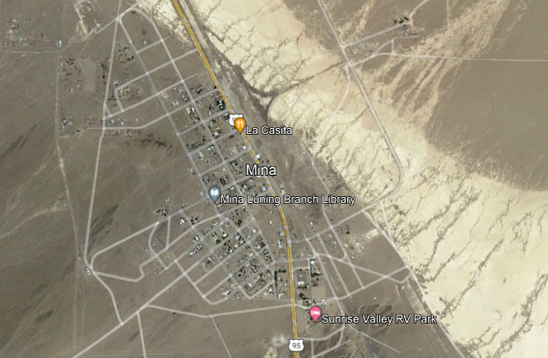
Hawthorne Utilities – Mina & Luning Water System – PER Loan Request
Luning
Mina
Mina and Luning are small communities in Mineral County and are approximately 8.8 miles apart.

Slide 25
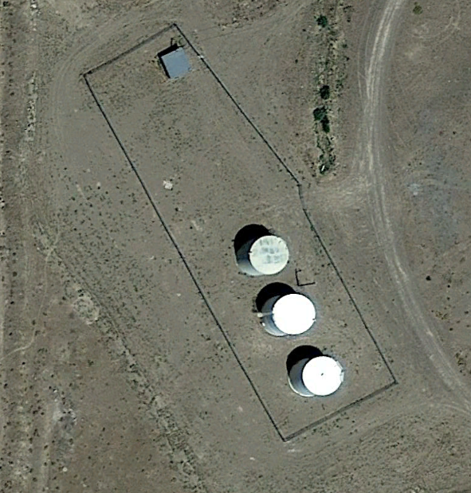
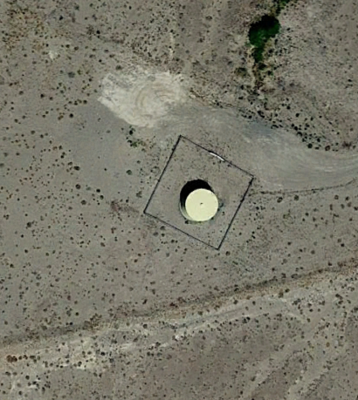
Proposed Project
Solicit engineering firm to complete PER and ER to evaluate source water availability and storage needs and evaluate the condition of existing storage facilities.
Currently, the only active Luning well exceeds MCL’s for arsenic and Luning is receiving drinking water from Mina’s production well.
Tank inspection reports completed in 2012 had determined that interior coating in the three Mina water storage tanks and the Luning tank has failed completely.
Corrosion of floors of the tanks was noted.
Mina Tanks
Luning Tank
Notes:
Please note that the LCE staff report references the water capacity of 132,000 gallons when referring to the tank size.
Current standards require a guardrail on top of the tank and a silt stop to extend 4-6 inches above floor.

Slide 26
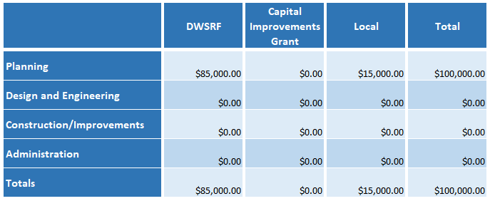
Project Cost Estimates and Funding Sources

Slide 27
Estimated Project Schedule
PER and ER: January – September 2023

Slide 28
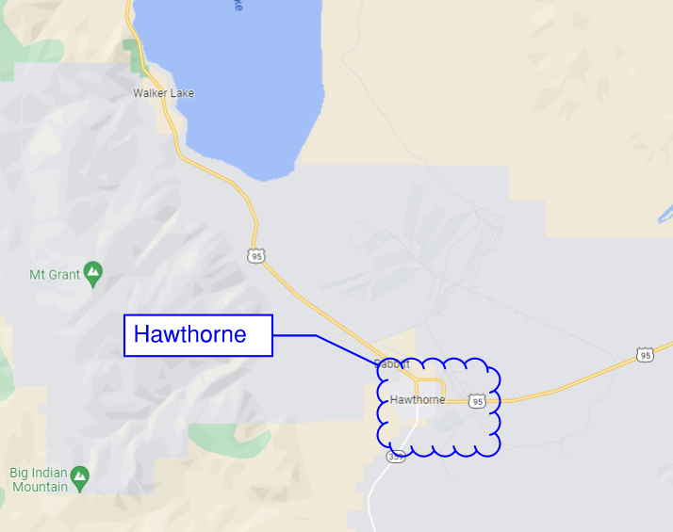
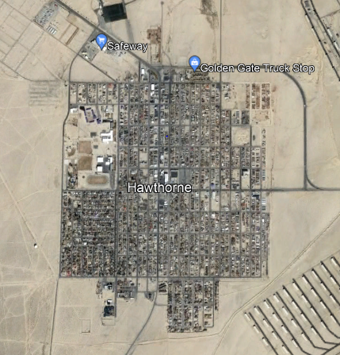
Hawthorne Utilities – Hawthorne Water System – PER Loan Request
Hawthorne is a small community in Mineral County with an approximate population of 3,300.

Slide 29
Proposed Project
Hawthorne wishes to solicit an engineering firm to evaluate the condition of the aging water system and propose and prioritize replacements and improvements to the transmission and distribution facilities. This system has been observed to experience leaks, breaks, and loss of water pressure.
The PER will also address the need to replace the I-Street well, which has experienced a reduction in capacity and is observed to have corroded equipment.

Slide 30
Project Cost Estimates and Funding Sources

Slide 31
Estimated Project Schedule
PER and ER: January – August 2023

